Slide 1
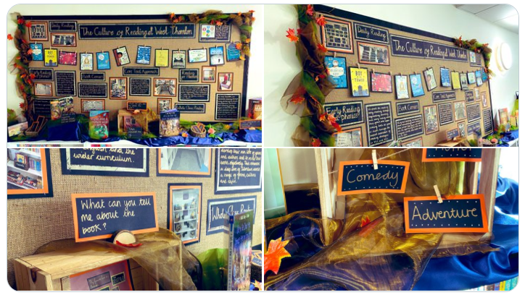

Reading at Home
West Thornton Primary School
Leah Hefetz

Slide 2

WHY IS READING SO IMPORTANT?
Reading is the gateway to learning
Learning to read supports the children so they can learn everything else
They can travel to far away lands and discover the most incredible characters
They can learn new words that they can use in their own writing
Notes:
Learning to read is about listening and understanding as well as working out what’s printed on the page. Through hearing stories, your children are exposed to a wide range of words. This helps them to build their own vocabulary and improve their understanding of the story.
Reading is the gateway to learning and supports the building of knowledge and many key skills.

Slide 3
READING HAS TWO COMPONENTS
Word Recognition
Comprehension
Recognising words presented in and out of context.
The ability to apply phonic rules - blending phonemes to decode.
Quality phonics work – main approach for beginners in learning to decode ( sound out).
The process by which words, information and sentences are interpreted and understood.
The same applies to both spoken and written understanding.
Continues to develop throughout life!
Notes:
Reading has two components. The first is word recognition. This is where the children can decode and recognise key words that they read.
The second is reading comprehension, which is the ability to understand what is being read. Both are essential for successful reading.

Slide 4

DEVELOPING WORD RECOGNITION SKILLS
Phoneme (letter sound) awareness and phonics teaching
Repetition and teaching of ‘tricky’ words which may not be phonetically plausible
Recognising patterns in words.
c-a-t
Notes:
There are many ways to help develop word recognition skills. You can encourage the children to use their phonics to segment and blend unfamiliar words and continue to support them with their learning of ‘tricky’ words, which many not be phonetically plausible. They can also make connections to patterns they recognise in words e.g. comparing sounds across multiple words

Slide 5


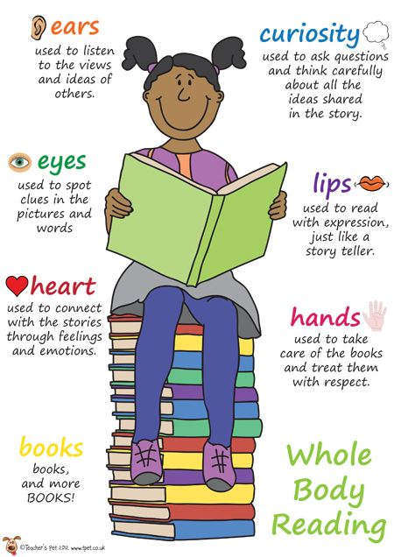
READING AT HOME
Be a good role model:
Find some time in the day to read yourself
Let your children see that you get pleasure from reading
Share your favourite books/reading material with them – even books you enjoyed reading as a child.
Notes:
When reading at home, it is important that we model the correct reading behaviours ourselves. Find some time in the day to read yourselves and let your children see that you enjoy reading. Even share your favourite books and explore these together.

Slide 6
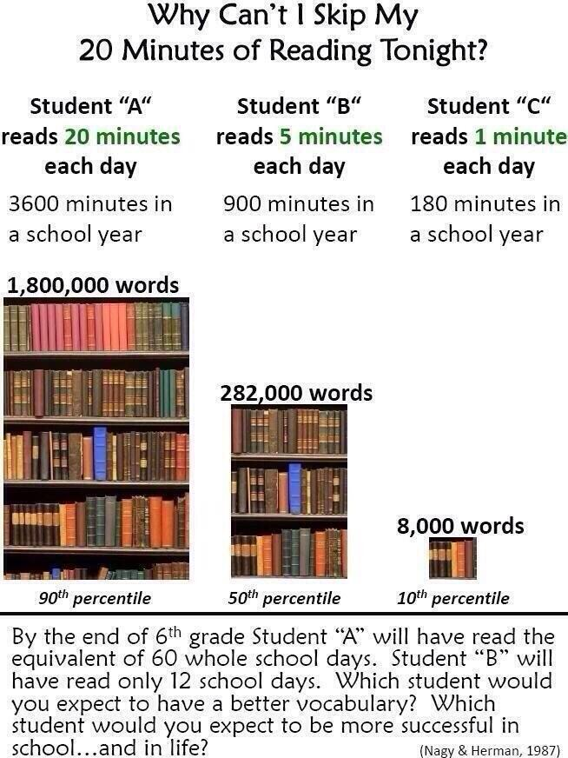

BENEFITS OF READING DAILY
What can the children do with all those words that they learn from reading?
Notes:
There are many benefits of reading daily. This image demonstrates the number of words the children are exposed to through reading for a short amount of time every day. They can use all those new words in their conversations and writing.

Slide 7
WHAT CAN THEY READ AT HOME?
Reading should be for enjoyment and interest.
A school reading book is only ONE part of a child’s reading repertoire.
Books (picture books; short stories; chapter books); magazines; comics; annuals; football programmes; poetry.
Information books; brochures; catalogues; flyers; newspapers; guide-books; eBooks; kindle.
Websites; take-away menus; instructions.
Visit the library and bookshops.
Notes:
Reading should be for both enjoyment and interest and can be encouraged through many different genres and types of text. There are many examples on the screen, which include fiction, non-fiction and poetry. They could read instructions to create something, magazines, information books or even different poems. Try to encourage your children to read a variety to support keep them engaged.

Slide 8
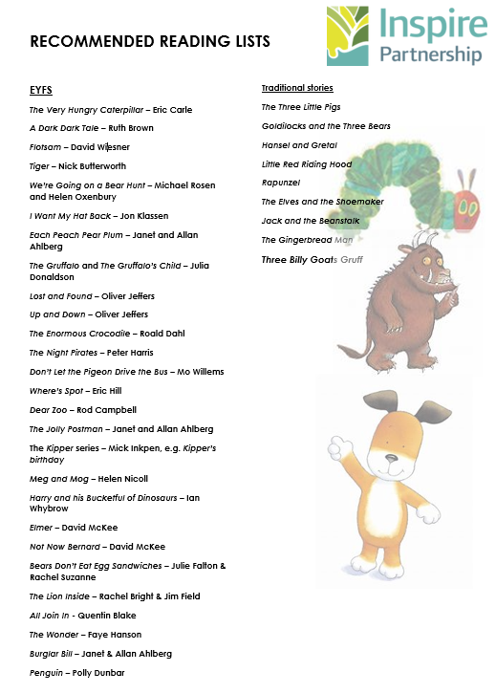
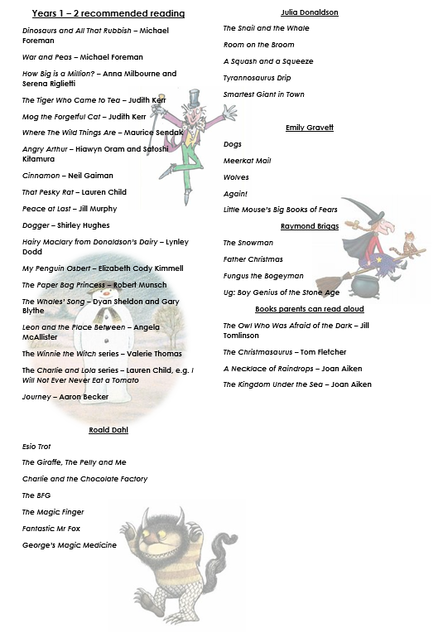
Notes:
We have produced a recommended reading list for each key stage. There you can find a variety of different genres for your children to explore. Here are the EYFS and Years 1 and 2 lists. We will share these on our website.

Slide 9
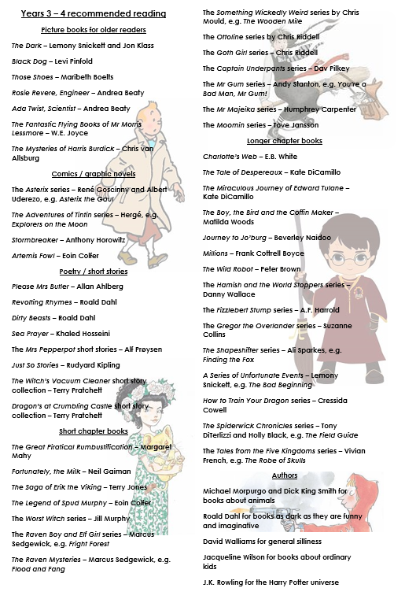
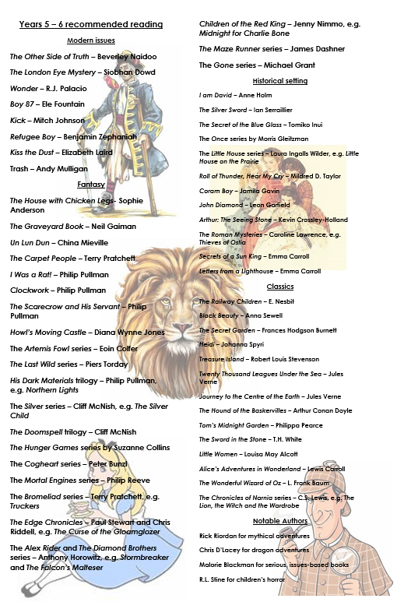
Notes:
And here are the years 3 and 4 and years 5 and 6 lists.

Slide 10

HOW OFTEN DO YOU READ WITH YOUR CHILDREN?
Daily?
Once or twice a week?
Less than that?
Regularly read with your child to monitor their progress and feedback to the teacher
Find a nice time in the evening where you are both relaxed and cosy, ready to listen to a fantastic story.
Notes:
Reading with your children is very beneficial for both you and them. When reading, you are able to facilitate a discussion based on the text and monitor their progress.
This should be a cosy and relaxed time for you both.

Slide 11
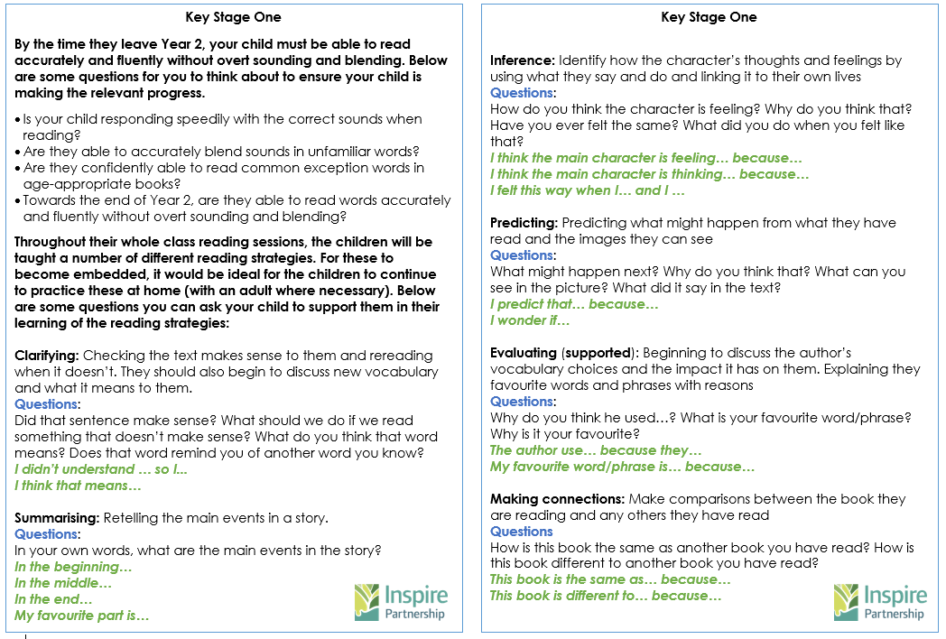
Year 1 and 2
Notes:
To support discussions at home, we have put together some resources to help you. As discussed previously, it is essential that all children have a good understanding of what they are reading and, through asking questions like those listed, the children will begin to think deeply about what they are reading. This is the years 1 and 2 example where an adult can ask the questions and the children can use the sentence stems provided to form their answers.

Slide 12
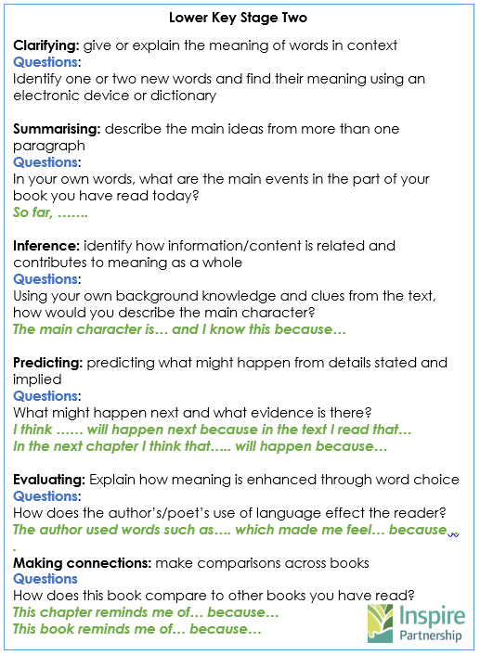
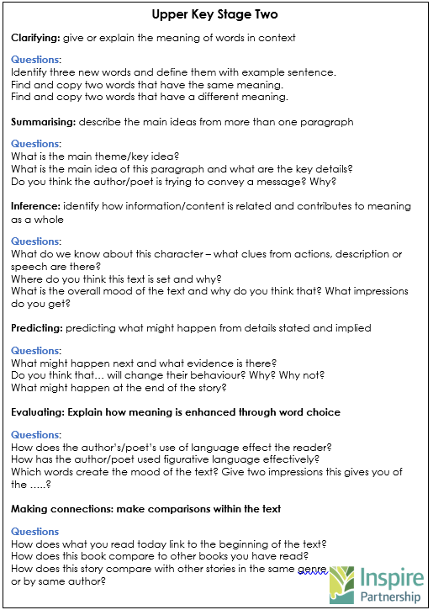
Year 3 and 4
Year 5 and 6
Notes:
As the children progress through the years, the questions encourage them to think much more deeply and begin to form their answers much more independently.

Slide 13
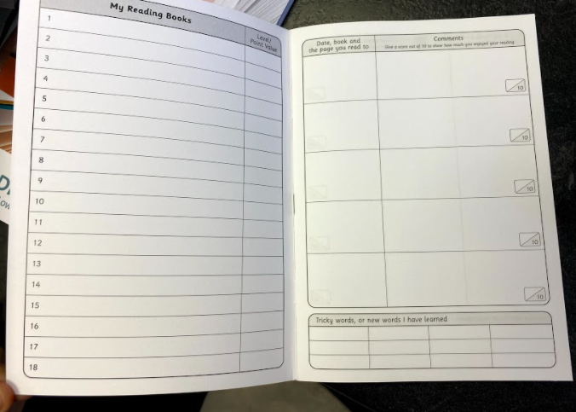

READING RECORDS
Children will be only bringing their reading records in once a week on the day shared by your class teacher.
Notes:
This year, we will continue to use our reading records to note down the books the children have used. At the bottom of the page, there is a box for the children to record any new words they have learning, which can then be used in their writing. At the moment, we will be collecting in the reading records once a week so please check with child’s class teacher.

Slide 14
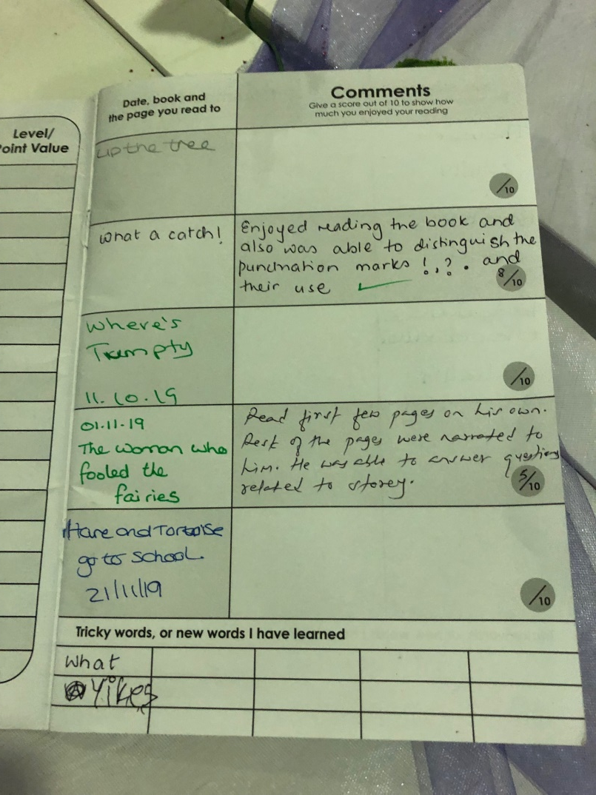
HOW TO USE OUR READING RECORDS?
EYFS/KS1
These children have been reading their books with an adult or older sibling. The adult has written a comment about the child’s reading (if they found the words easy/hard to read, if they enjoyed the book etc.)
Whoever reads to your child and listens to them read need to make a comment in their journal every day!

Slide 15
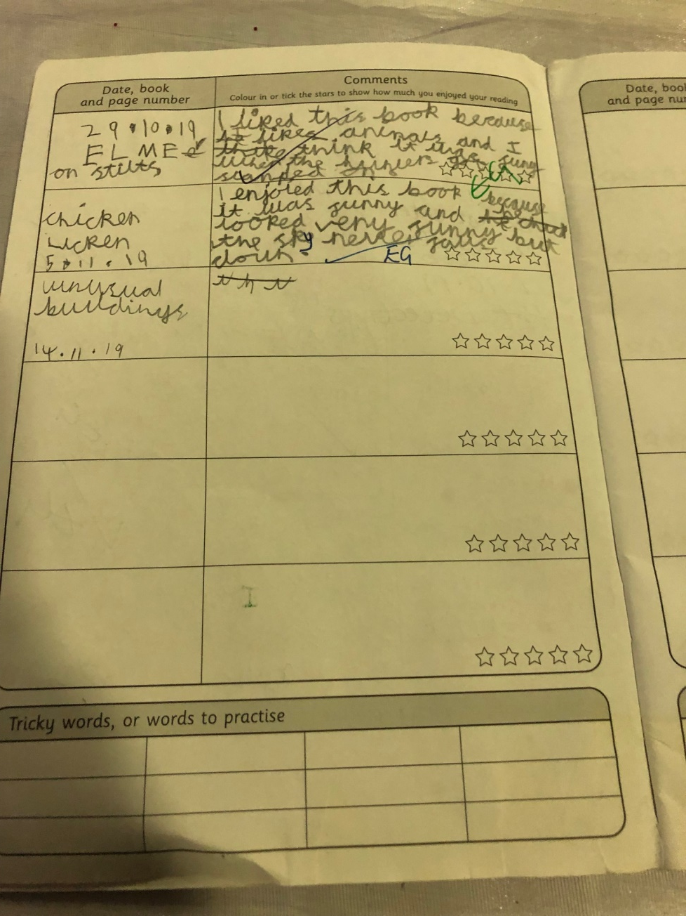
HOW TO USE OUR READING RECORDS?
KS1
This child has begun to also record their own comments in their reading record (alongside their adult). They have written down what they liked about the story and can now start to use their whole class reading strategies to extend their answers (predicting, clarifying, making connections, asking questions, inferring).

Slide 16
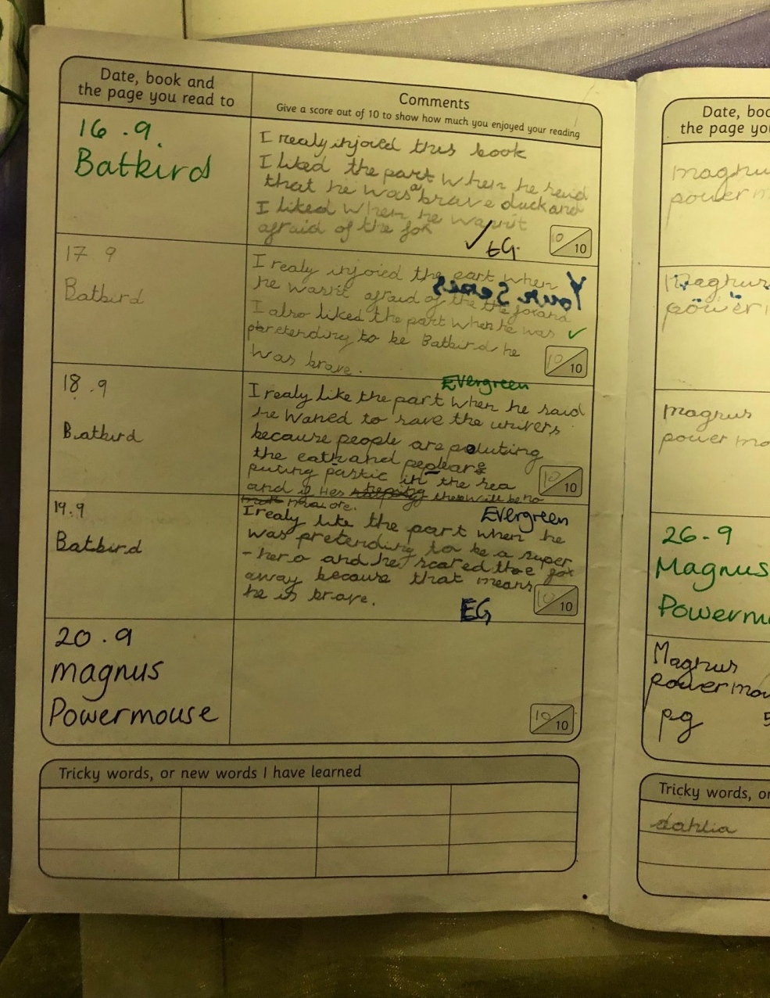
HOW TO USE OUR READING RECORDS?
KS2
This child has read the same book over several days. They have recorded their favourite parts from each section they have read by building on what they have read before.

Slide 17
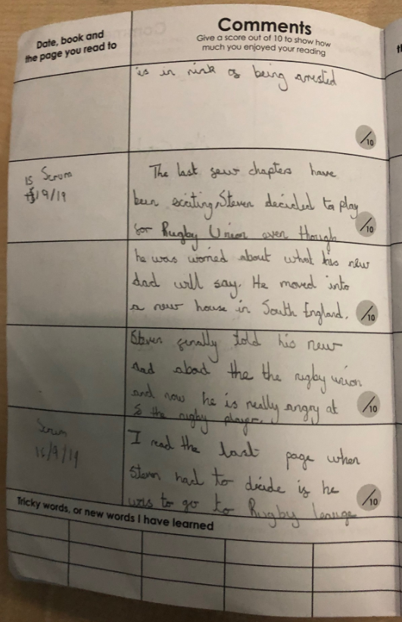
HOW TO USE OUR READING RECORDS?
KS2
This child has summarised the last few chapters they have read. They have described their favourite parts and explained why they enjoyed reading this section.

Slide 18
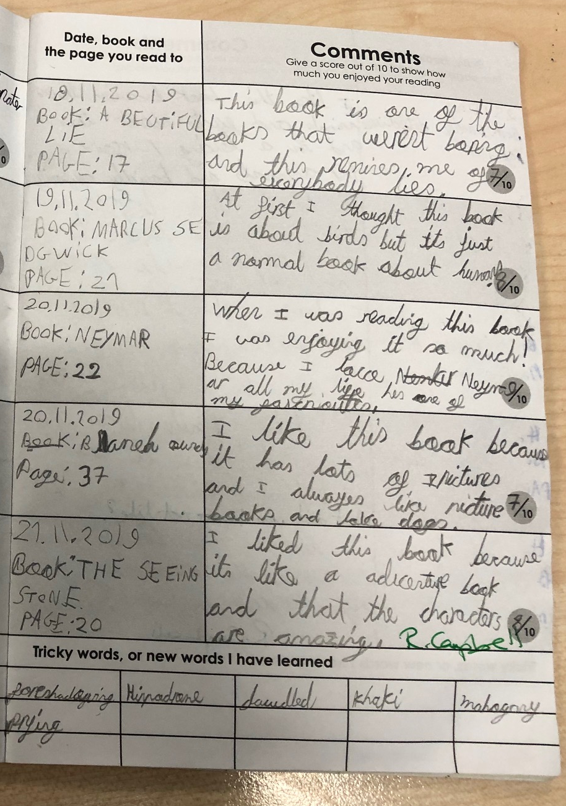
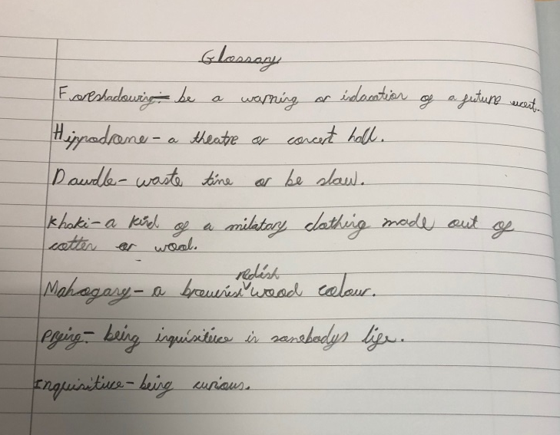

HOW TO USE OUR READING RECORDS?
When reading, if your child finds a word that they are unsure of, get them to record it in the grid at the bottom of their reading record. They can use their clarifying skills to find out what these words mean and create a glossary in their home learning journal.
They can then use these words in their writing in school and share these with their friends to broaden their vocabulary.

Slide 19
WAYS TO HELP YOUR CHILD BECOME A BETTER READER.
Research has shown that children who read regularly at home believe they are ‘Good at Reading’, and are therefore keen to move their reading forward for their own enjoyment.
Encourage them to read every day (15 minutes a day), make this a REGULAR ROUTINE!
Remind them to ‘read on’ or ‘back’ to check word meanings.
Talk about words they do not understand, try to work out by the reading the whole sentence or paragraph, or look them up.
Support them in writing a comment in their home school reading record, noting what they have enjoyed, or any new words they may have encountered.
Notes:
There are many ways in which you can help your child to become a better reader. Encourage them daily, remind them to clarify any words or phrases they don’t understand and support them with their discussions.

Slide 20
KEY MESSAGES
Try to listen to and read with your child regularly
Find a quiet place to share books where you can feel comfortable and relaxed
Encourage your child to have a go at reading words, by using phonic skills to read any unfamiliar words, and by working on building up their sight vocabulary.
Talk about the meanings of words to help to develop your child’s understanding and use of language.
Encourage your child to read a range of texts.
Read books to your child as well; if they see you enjoying a book it will encourage and motivate them to want to learn to read.
Ask them questions about the text to develop their understanding
Notes:
Try and listen to and read with your child regularly, help them to problem solve when they come across words they do not understand, encourage them to a variety of text types and help them develop their understanding through questions.

Slide 21
QUESTIONS? SUGGESTIONS?

