Slide 1
MATHS
Day 1

Slide 2
LI: To be able to count forwards and backwards to 10.

Slide 3
WHAT IS COUNTING?
WHAT CAN WE USE TO COUNT?

Slide 4
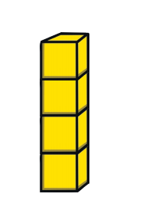
HOW MANY ARE THERE?

Slide 5

HOW MANY ARE THERE?

Slide 6
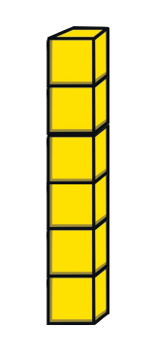
HOW MANY ARE THERE?

Slide 7

HOW MANY ARE THERE?

Slide 8

HOW MANY ARE THERE?

Slide 9

HOW MANY ARE THERE?

Slide 10
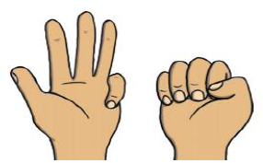



TODAY YOU WILL BE MATCHING A NUMBER WITH THE IMAGE
Which number represents which image?

Slide 11
MATHS
Day 2

Slide 12
LI: To compare objects in a range of contexts.

Slide 13
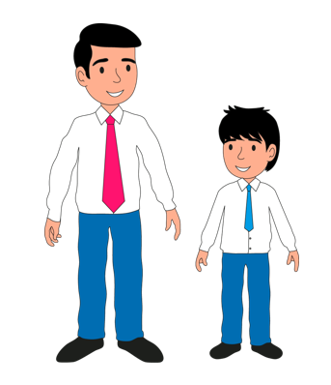
WHICH ONE IS TALLER?

Slide 14
WHICH ONE IS TALLER?
The man is taller than the boy.

Slide 15
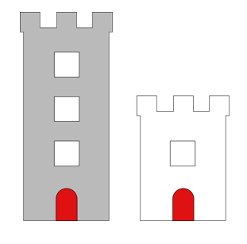

Slide 16
The grey tower is taller than the
white tower.
The white tower is shorter than
the grey tower.

Slide 17
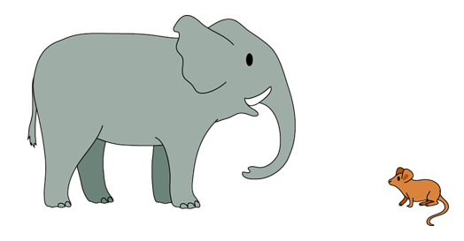
WHICH ONE IS BIGGER?

Slide 18
THE ELEPHANT IS BIGGER THAN THE MOUSE.
THE MOUSE IS SMALLER THAN THE ELEPHANT.

Slide 19
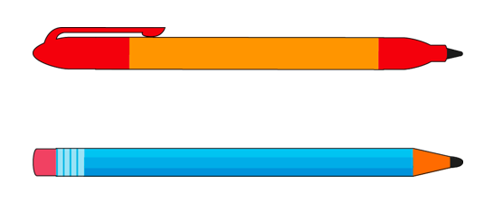
WHICH ONE IS LONGER?

Slide 20
THE PEN AND THE PENCIL ARE THE SAME LENGTH.

Slide 21
TODAY YOU WILL BE COMPARING OBJECTS AND USING SENTENCE STEMS
THE BOY IS SHORTER THAN THE MAN.

Slide 22
MATHS
Day 3

Slide 23
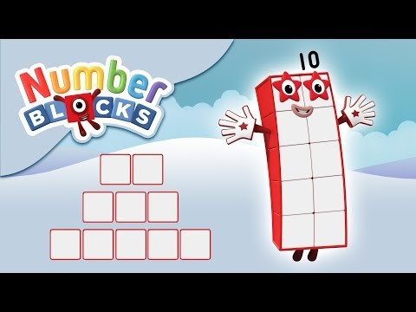
LI: To count and order numbers to 10.
Only watch for 2 min 19 sec.

Slide 24


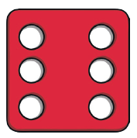
CAN YOU PUT THESE IN ORDER?

Slide 25
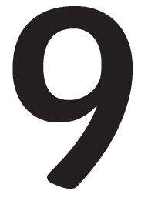


CAN YOU PUT THESE IN ORDER?

Slide 26



CAN YOU PUT THESE IN ORDER?

Slide 27
TODAY YOU WILL BE MAKING NUMBER BLOCKS USING UNIFIX CUBES AND MATCHING THEM TO NUMICONS

Slide 28
MATHS
Day 4

Slide 29
LI: To read and write numerals to 10.

Slide 30

HOW MANY COINS ARE HERE? HOW DO WE KNOW?

Slide 31

HOW MANY ARE HERE? HOW DO WE KNOW?

Slide 32
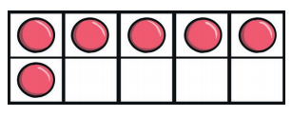
HOW MANY ARE HERE? HOW DO WE KNOW?

Slide 33
TODAY YOU WILL BE LEARNING TO RECOGNISE HOW MANY OF EACH THERE ARE AND TO WRITE NUMBERS TO 10.

Slide 34
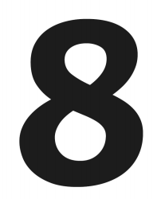
LET’S WRITE THESE NUMBERS IN THE AIR

Slide 35

LET’S WRITE THESE NUMBERS IN THE AIR

Slide 36
MATHS
Day 5

Slide 37
LI: To read and write numerals to 10 in words.

Slide 38

THERE ARE 4 DOGS. HOW DO WE WRITE 4 IN WORDS?
five
three
four

Slide 39

THERE ARE 3 BELLS. HOW DO WE WRITE 3 IN WORDS?
three
ten
two

Slide 40

HOW MANY CATS ARE THERE? HOW DO WE WRITE THIS IN WORDS?
ten
six
seven

Slide 41
TODAY YOU WILL BE WRITING NUMERALS IN WORDS
1 One
7 Seven

