Slide 1
Monday

Slide 2
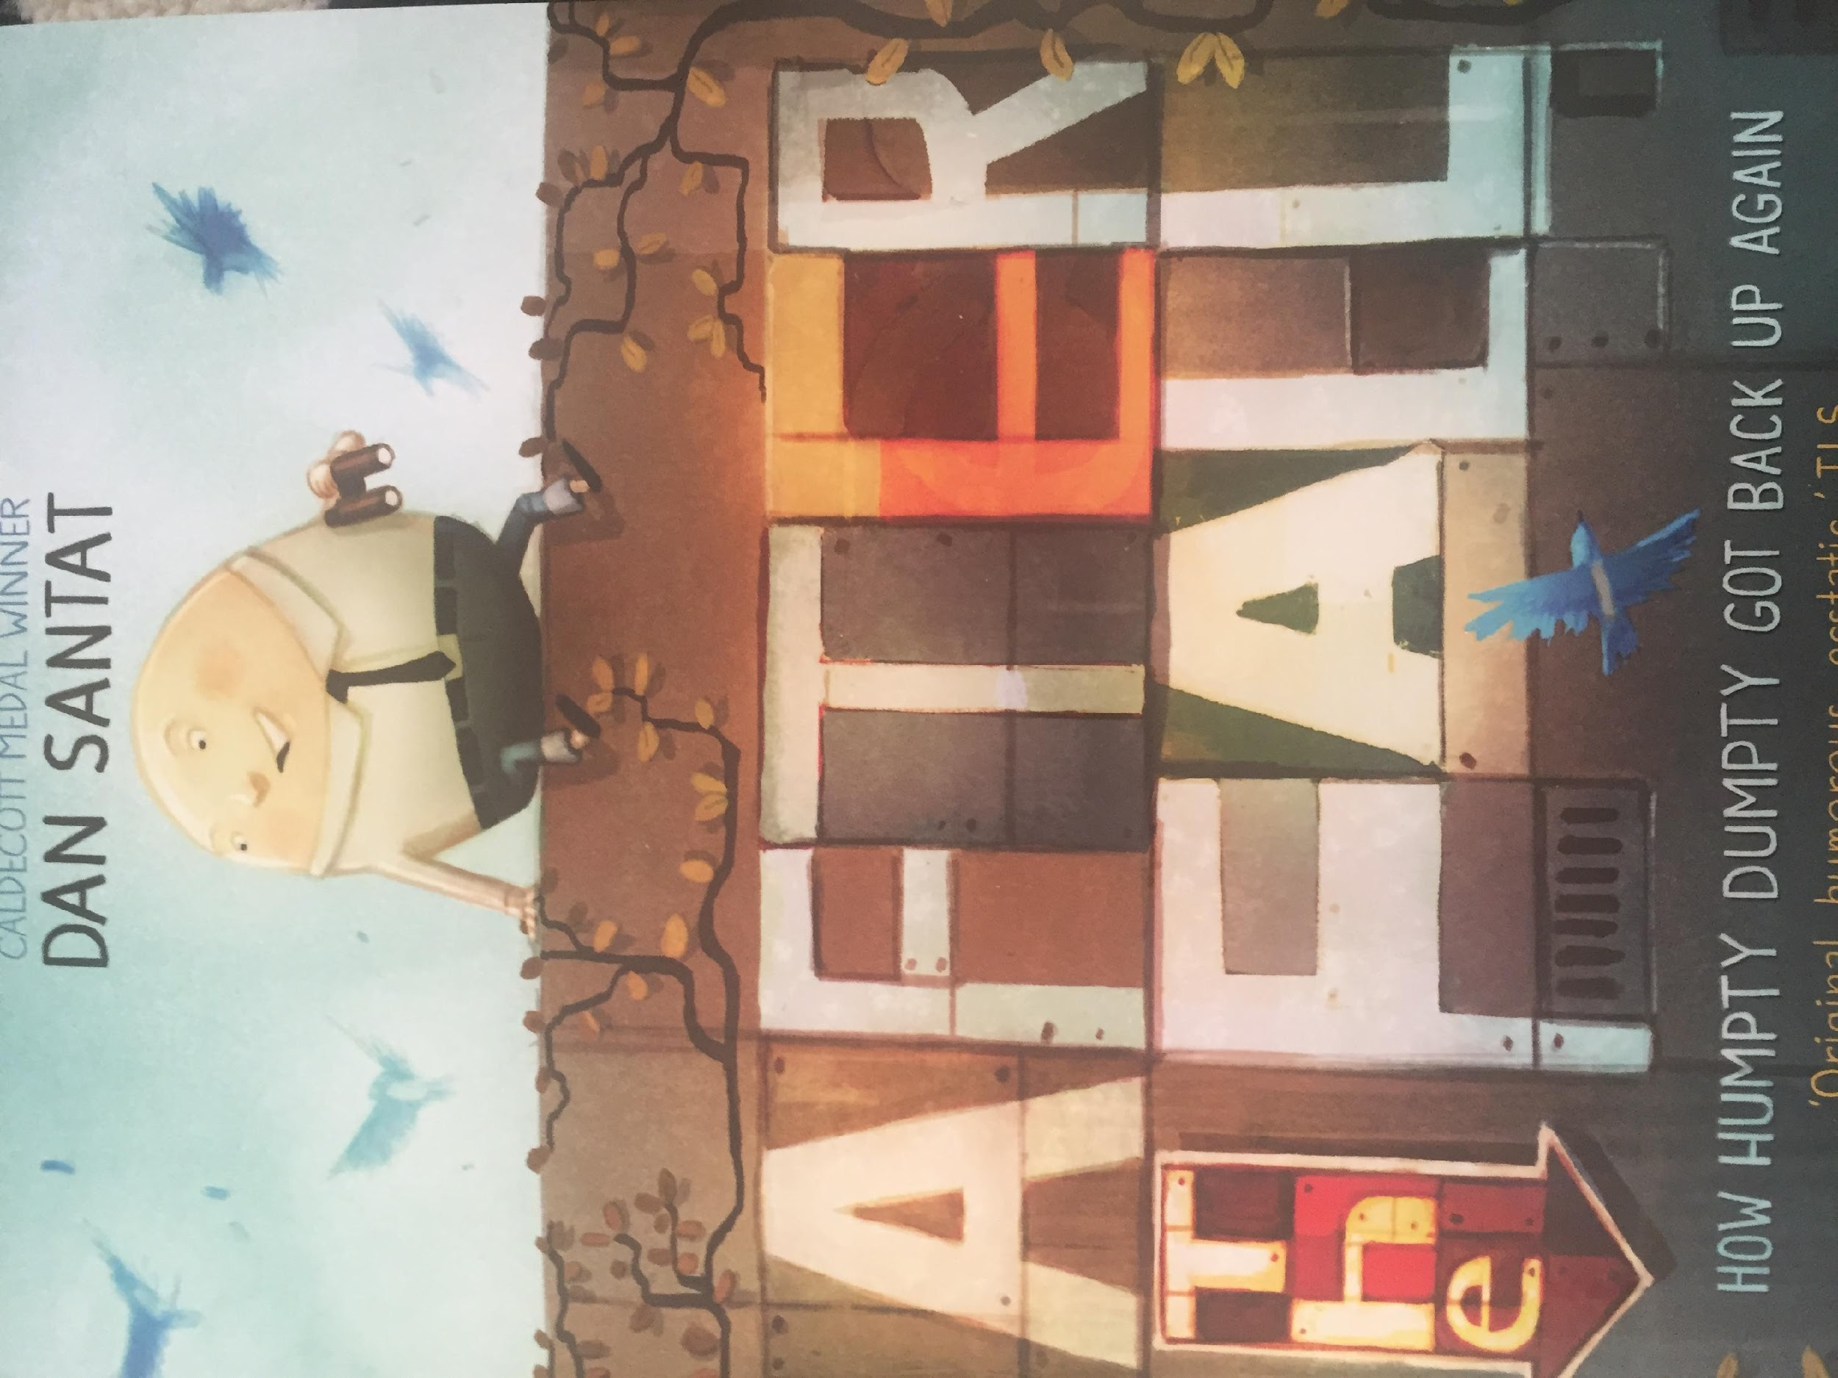
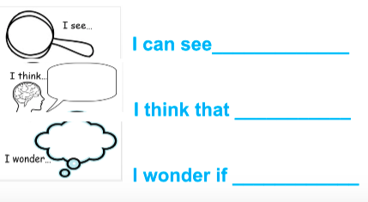

Slide 3


Slide 4
Tuesday

Slide 5
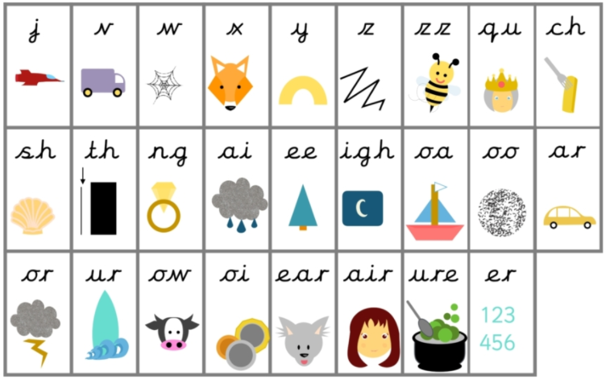
Before we start- let’s practice some of the sounds we might find in the text.

Slide 6
Now let’s practice some of the words we might find in the text.
fell
after
day
back
afraid

Slide 7
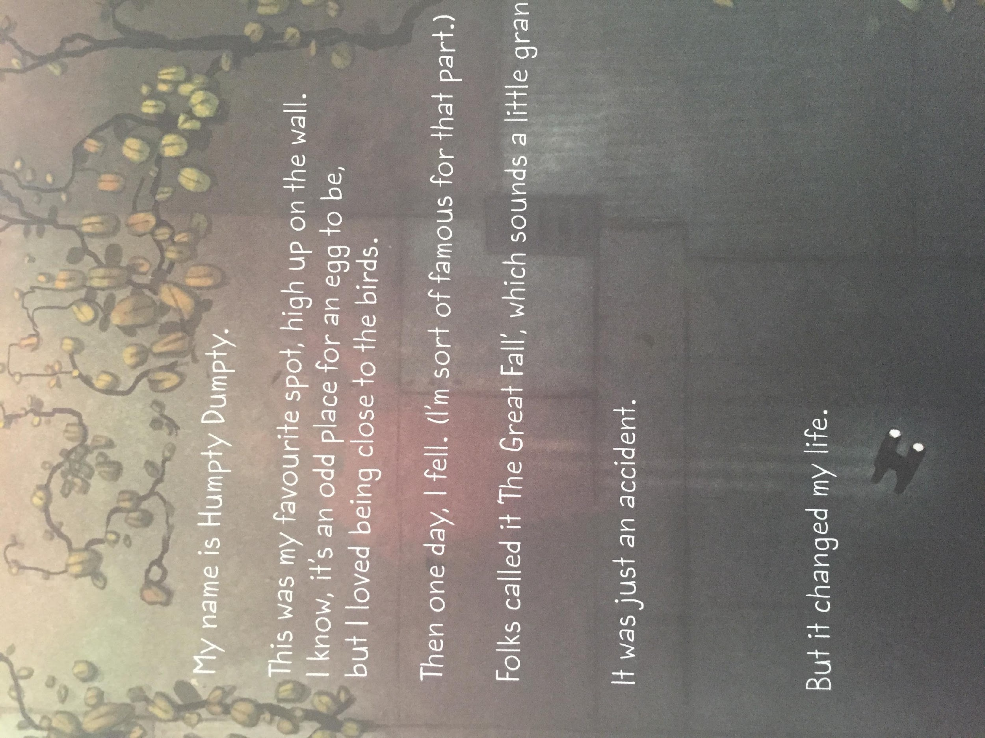

Slide 8
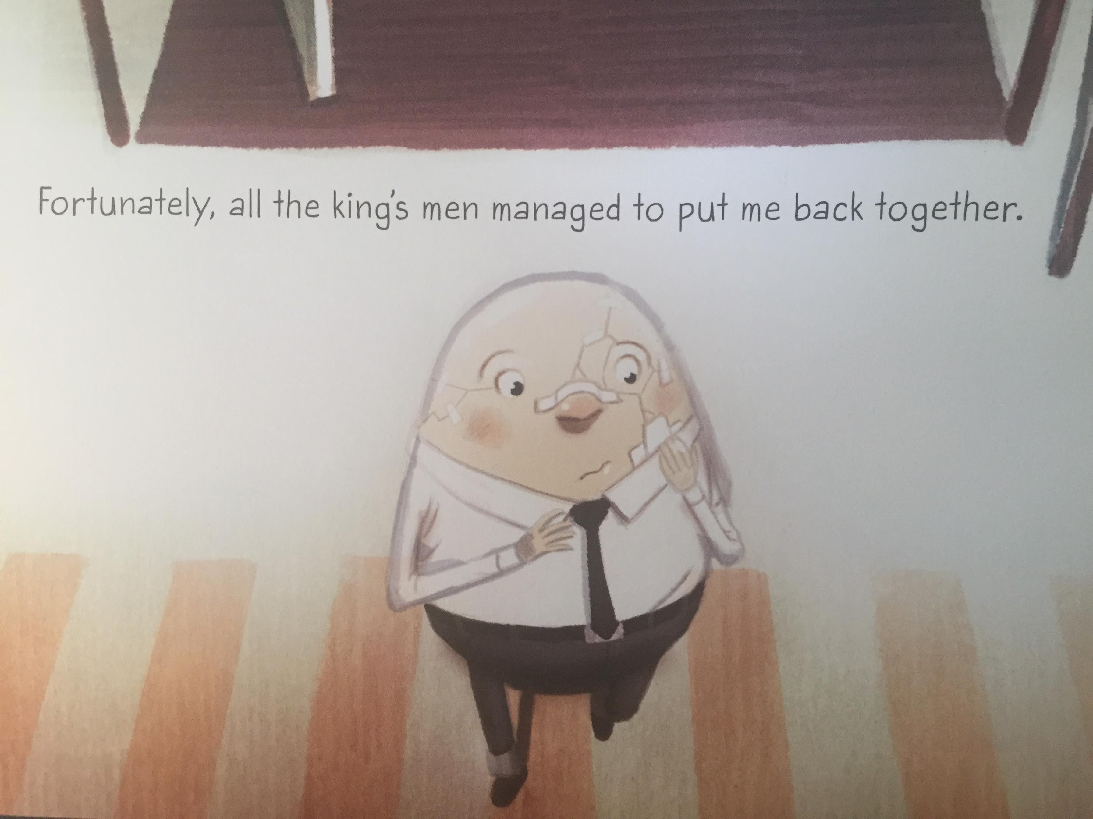

Slide 9
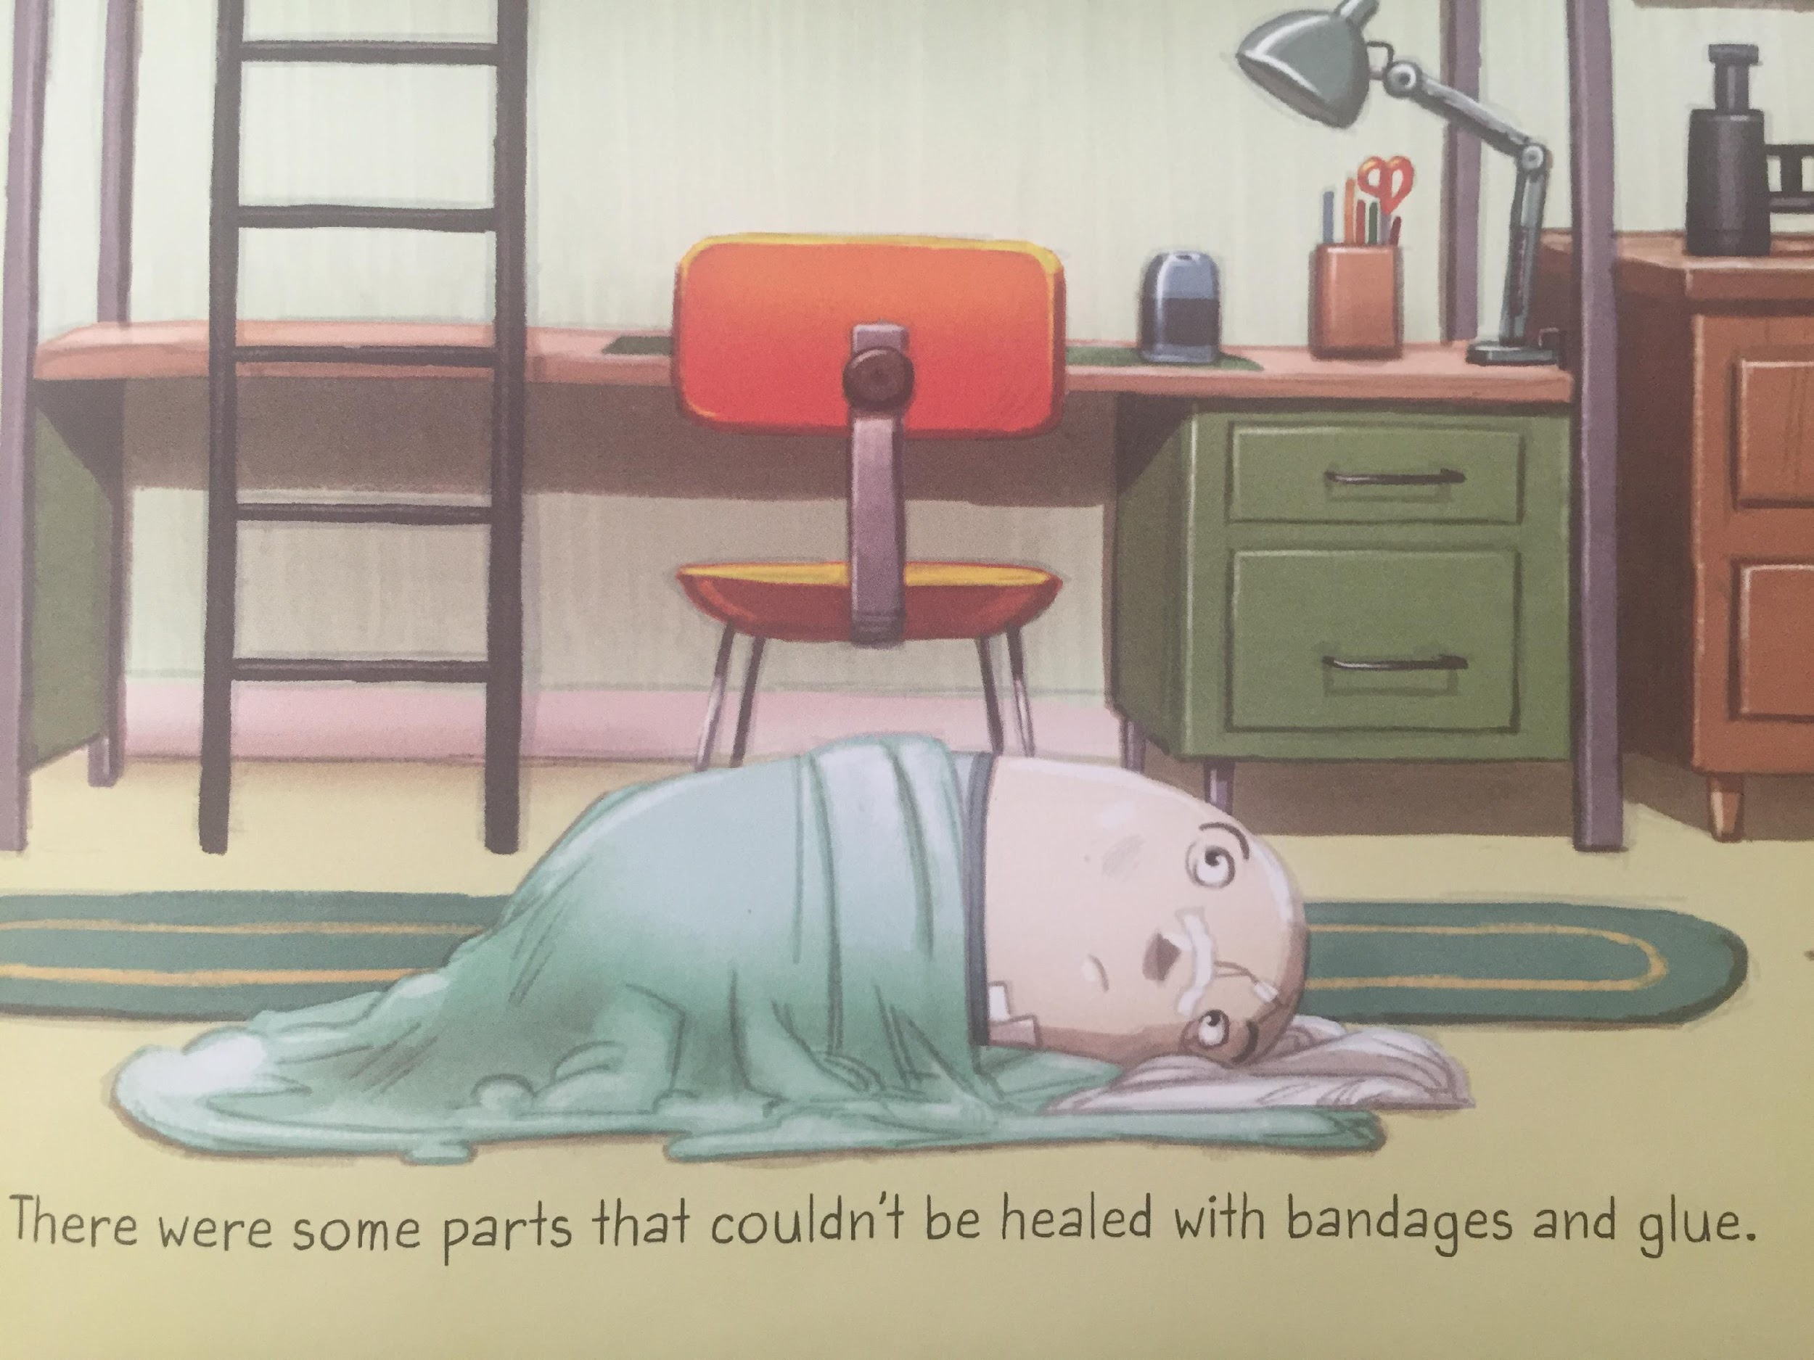
LI – to make links with my own life

Slide 10
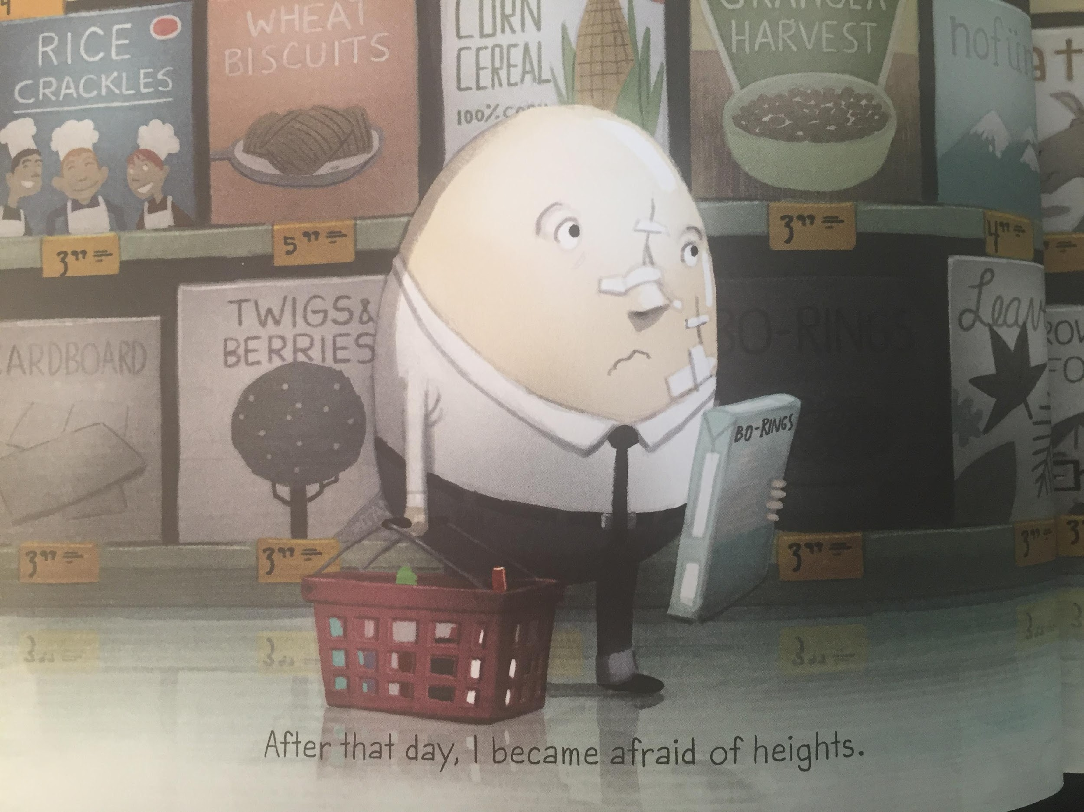
LI – to make links with my own life

Slide 11
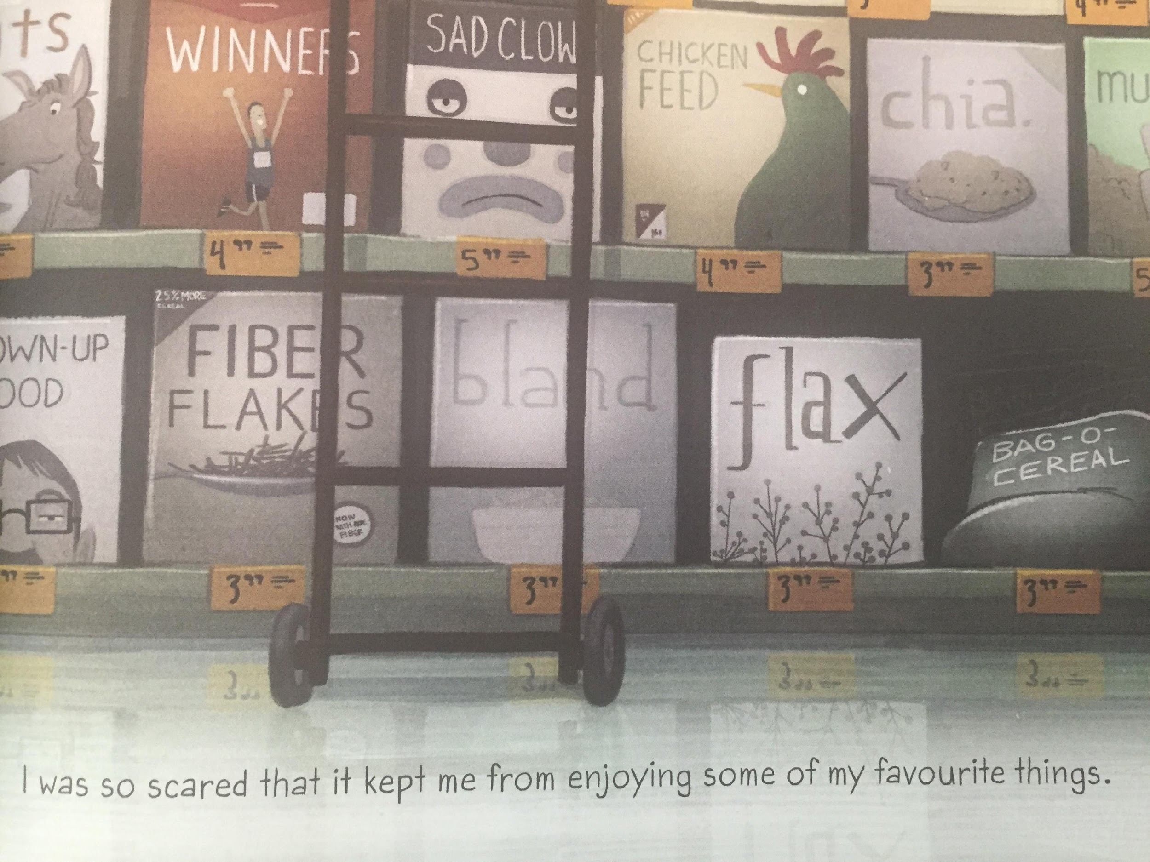

Slide 12
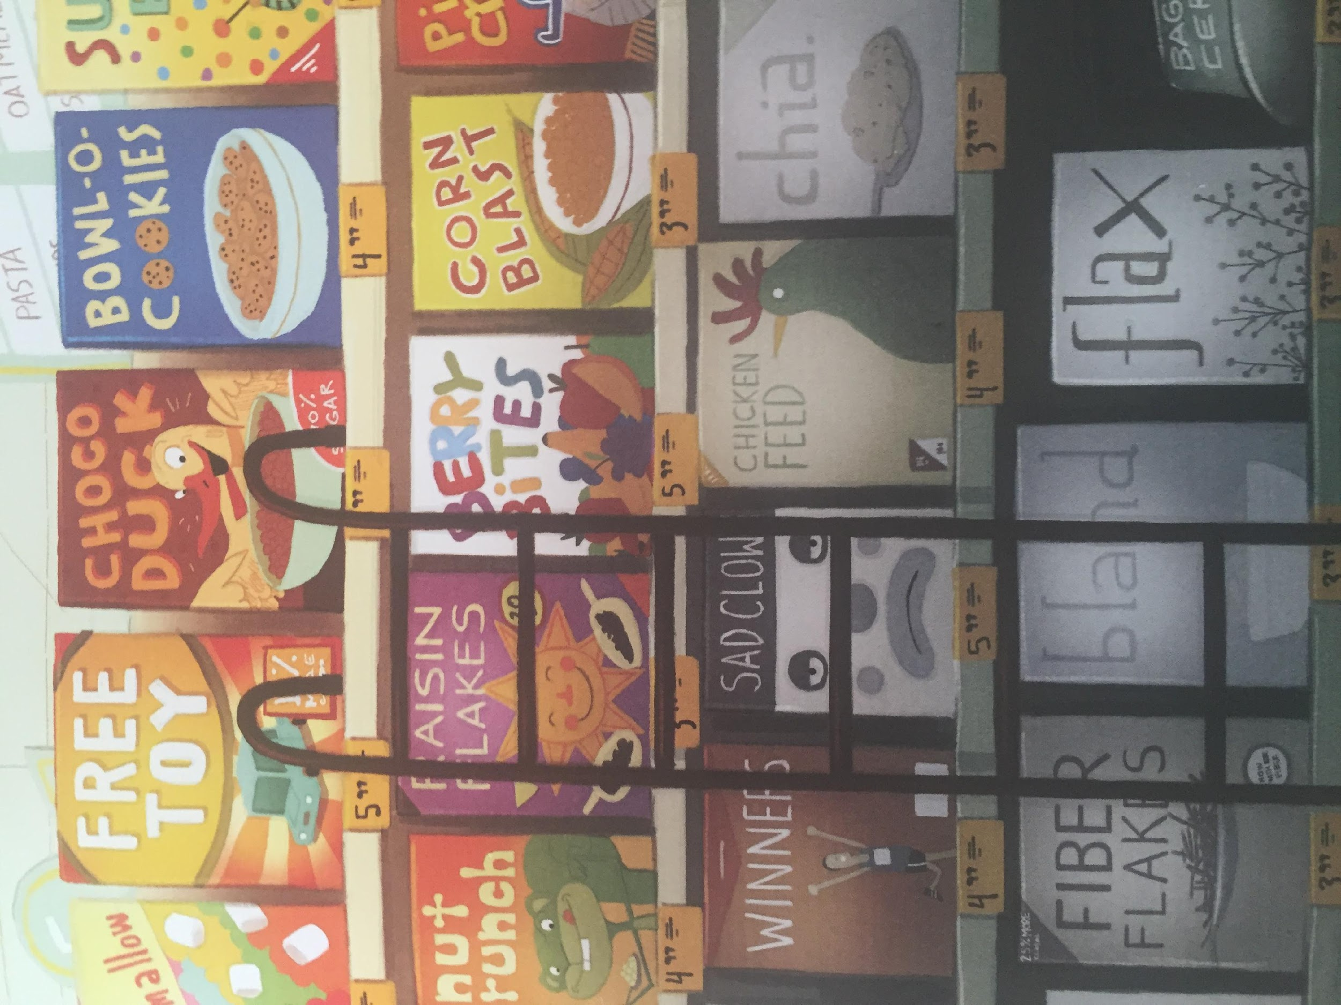
What experience does this make you think of ?
This makes me think of ... because. ...

Slide 13
Wednesday

Slide 14
Now let’s practice some of the words we might find in the text.
idea
high
bird
flew

Slide 15
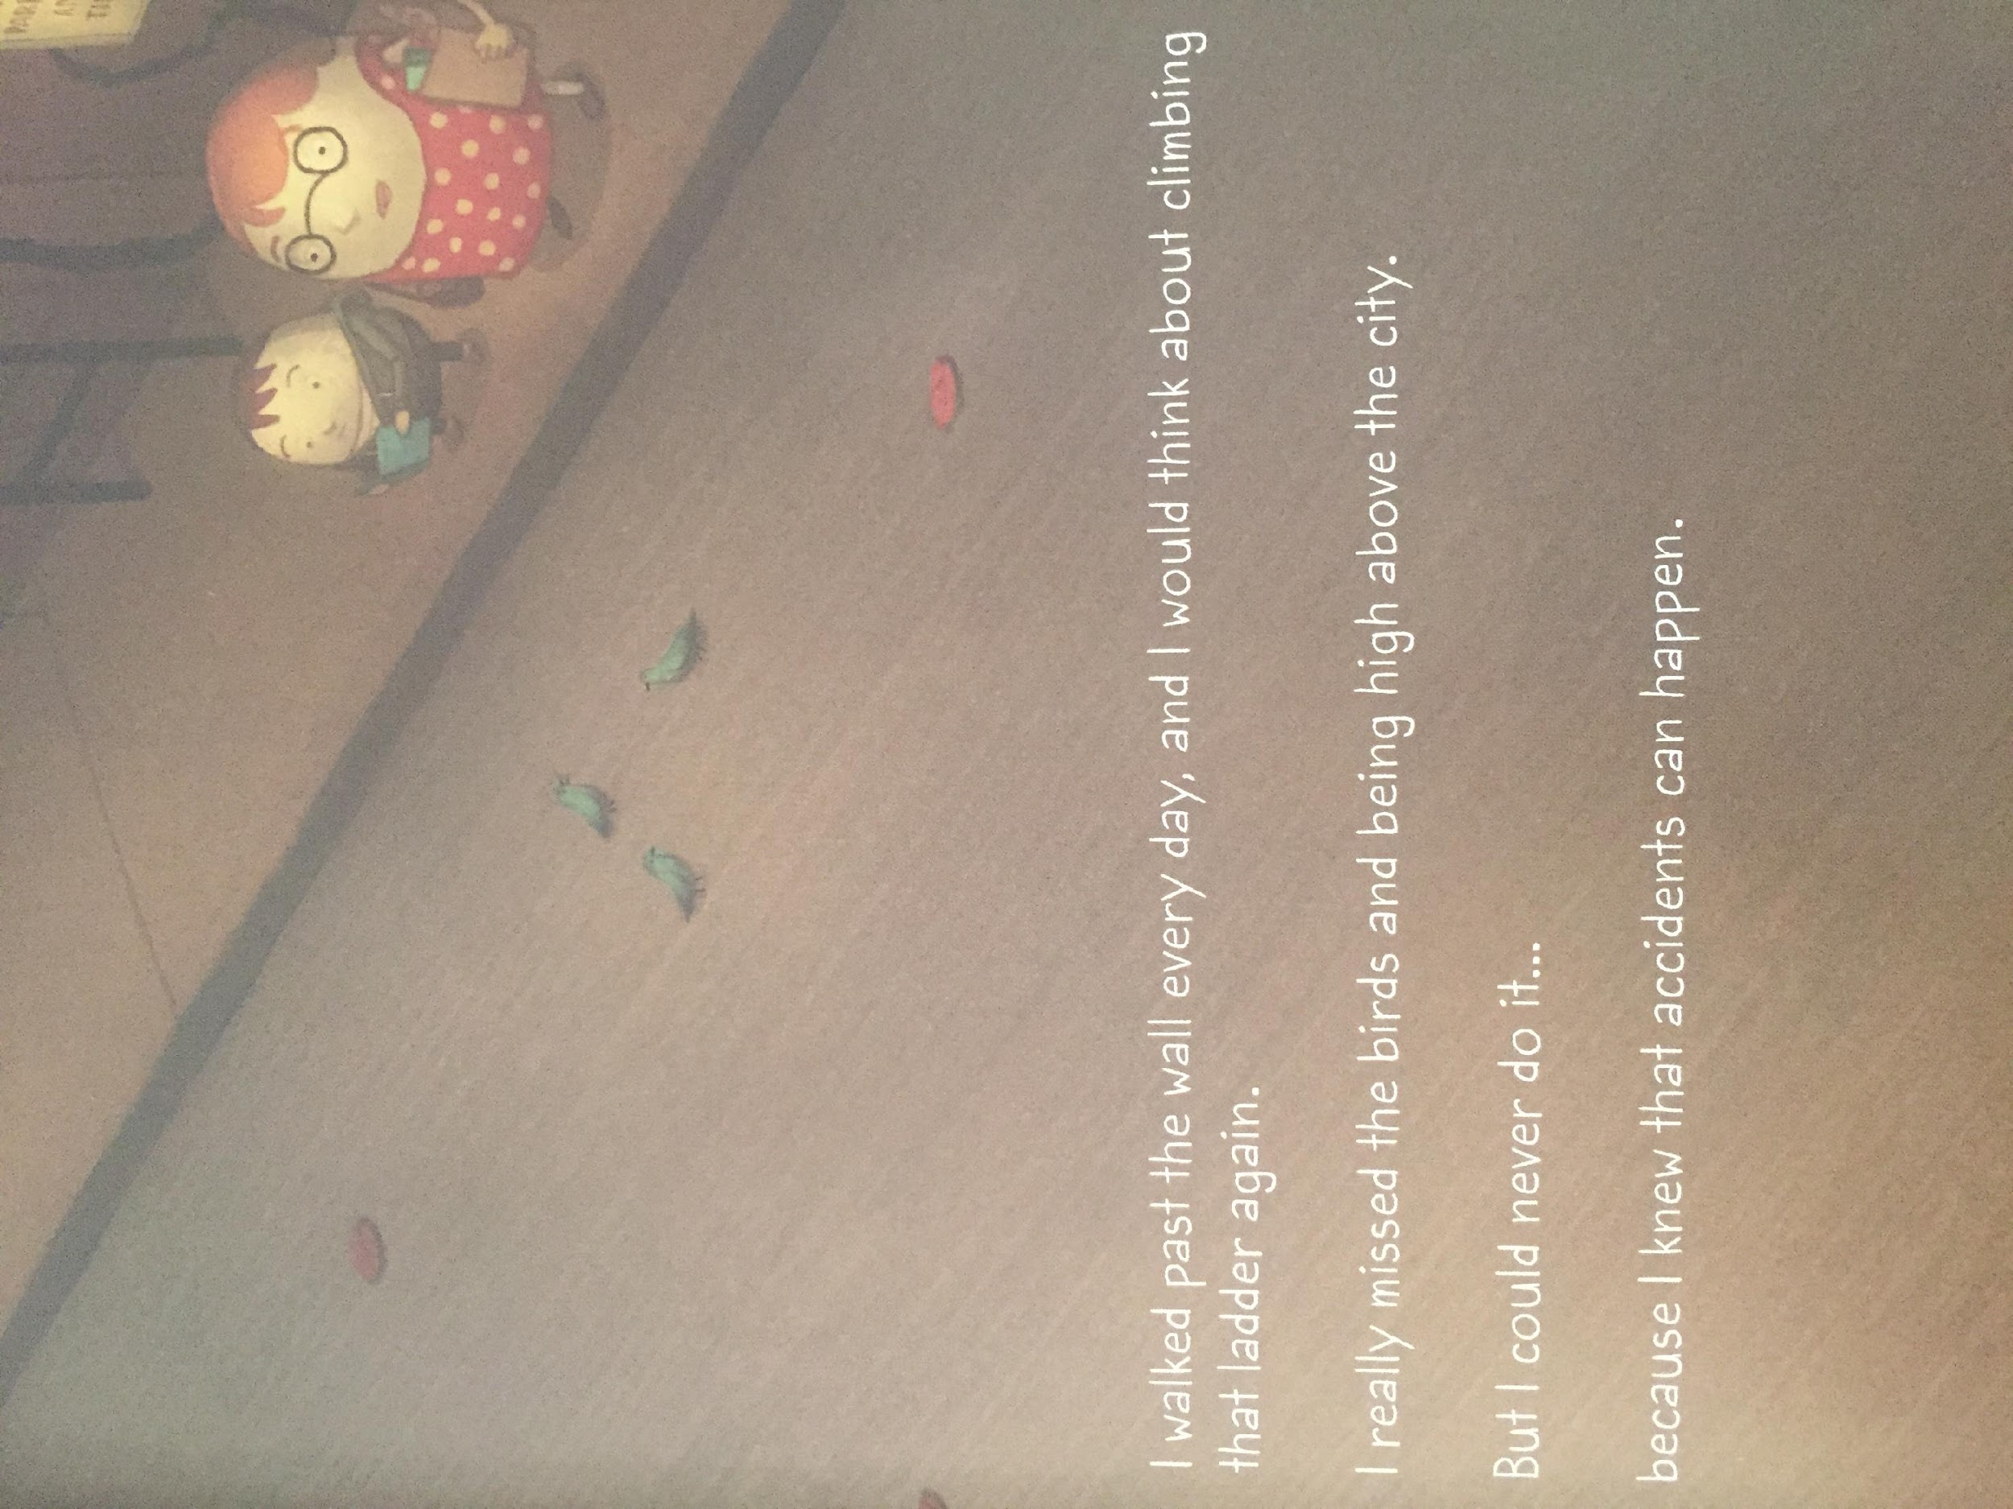
LI – to make links with my own life

Slide 16
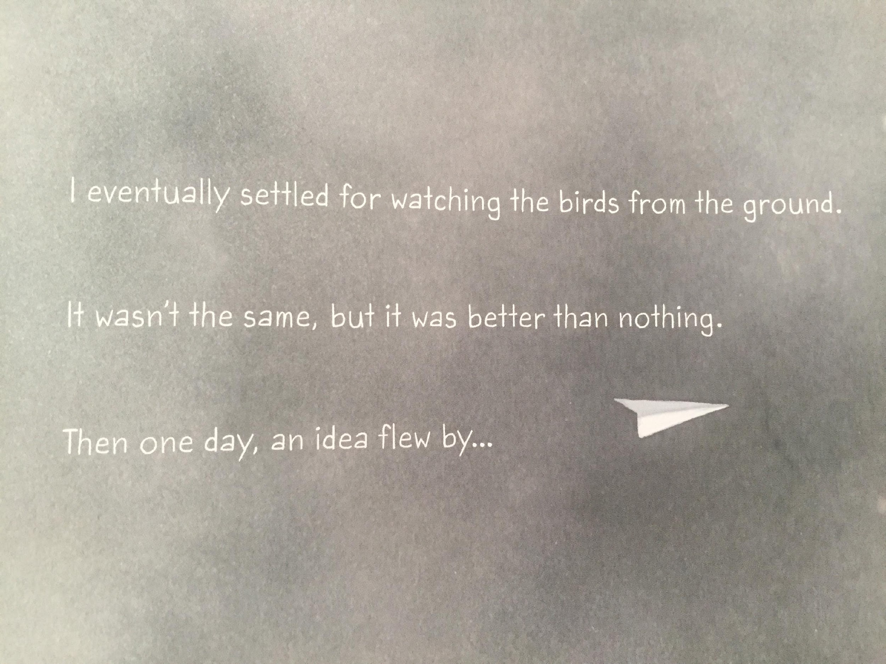
LI – to make links with my own life

Slide 17
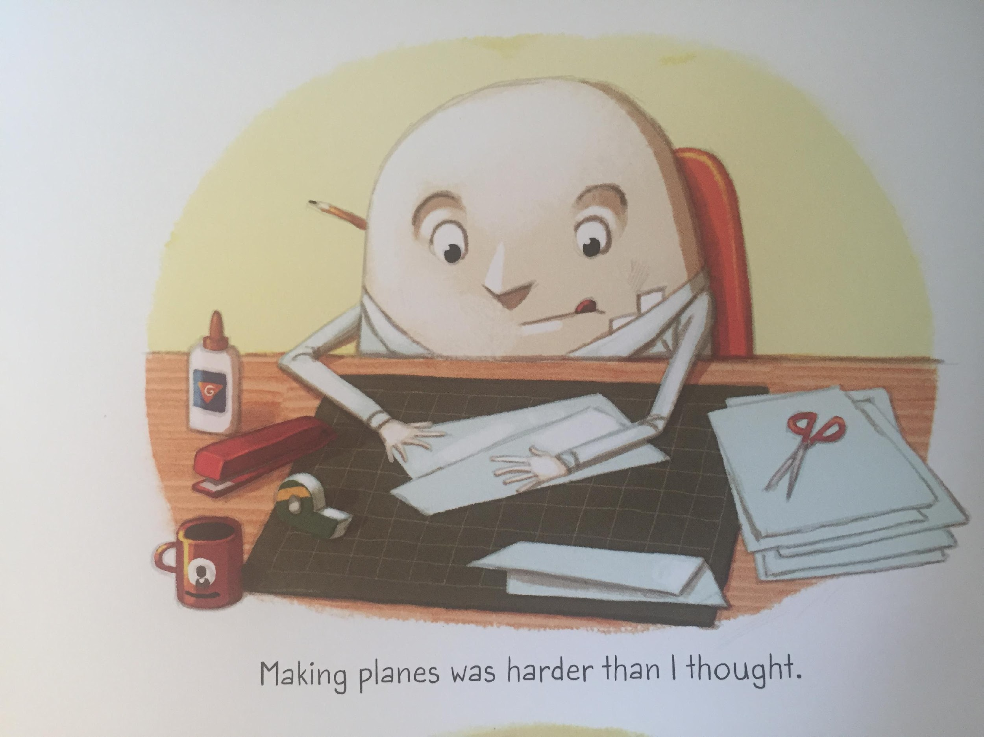
LI – to make links with my own life

Slide 18
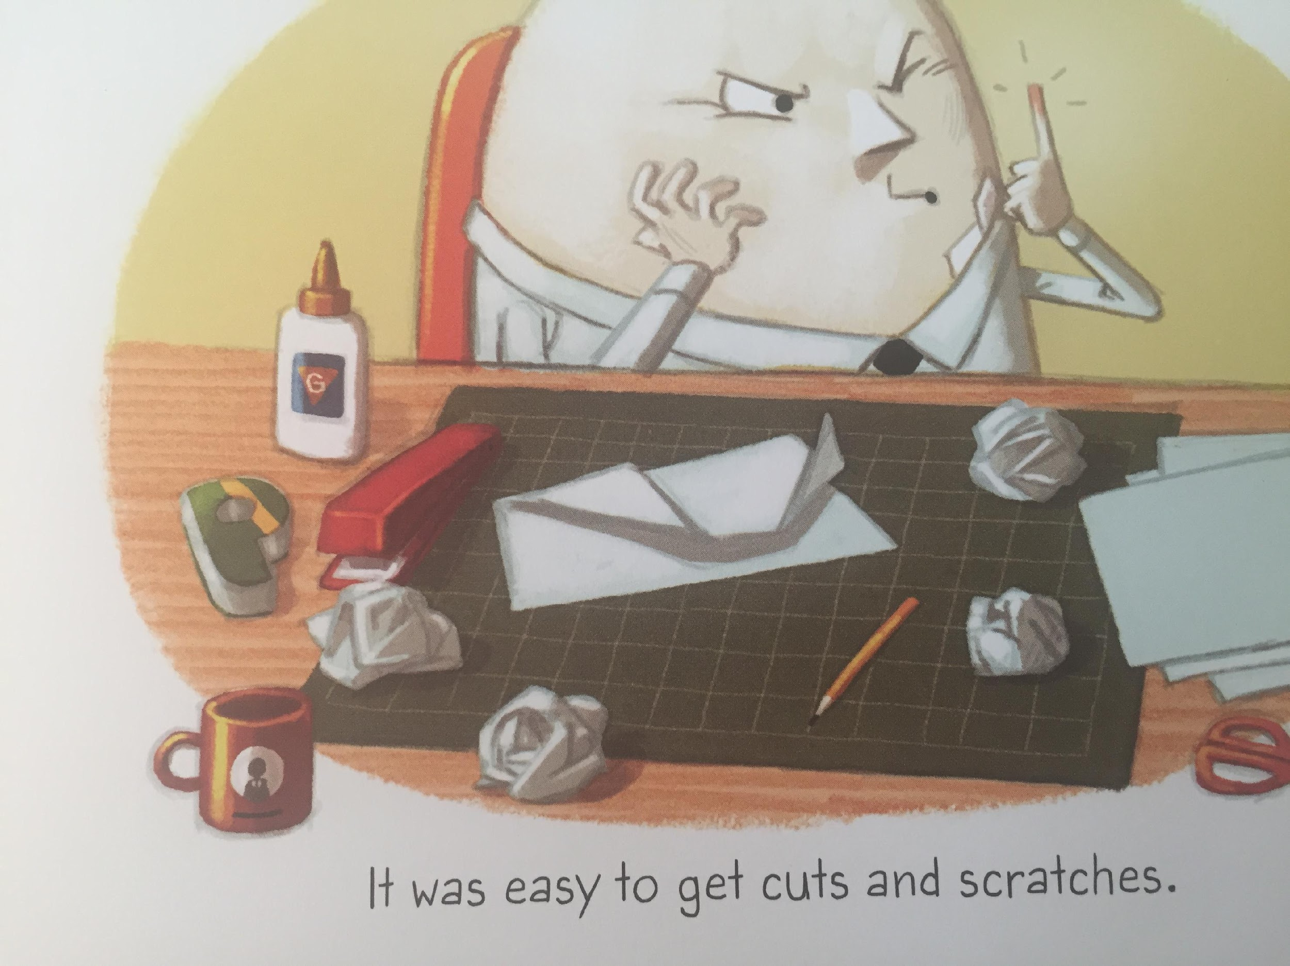
LI – to make links with my own life

Slide 19
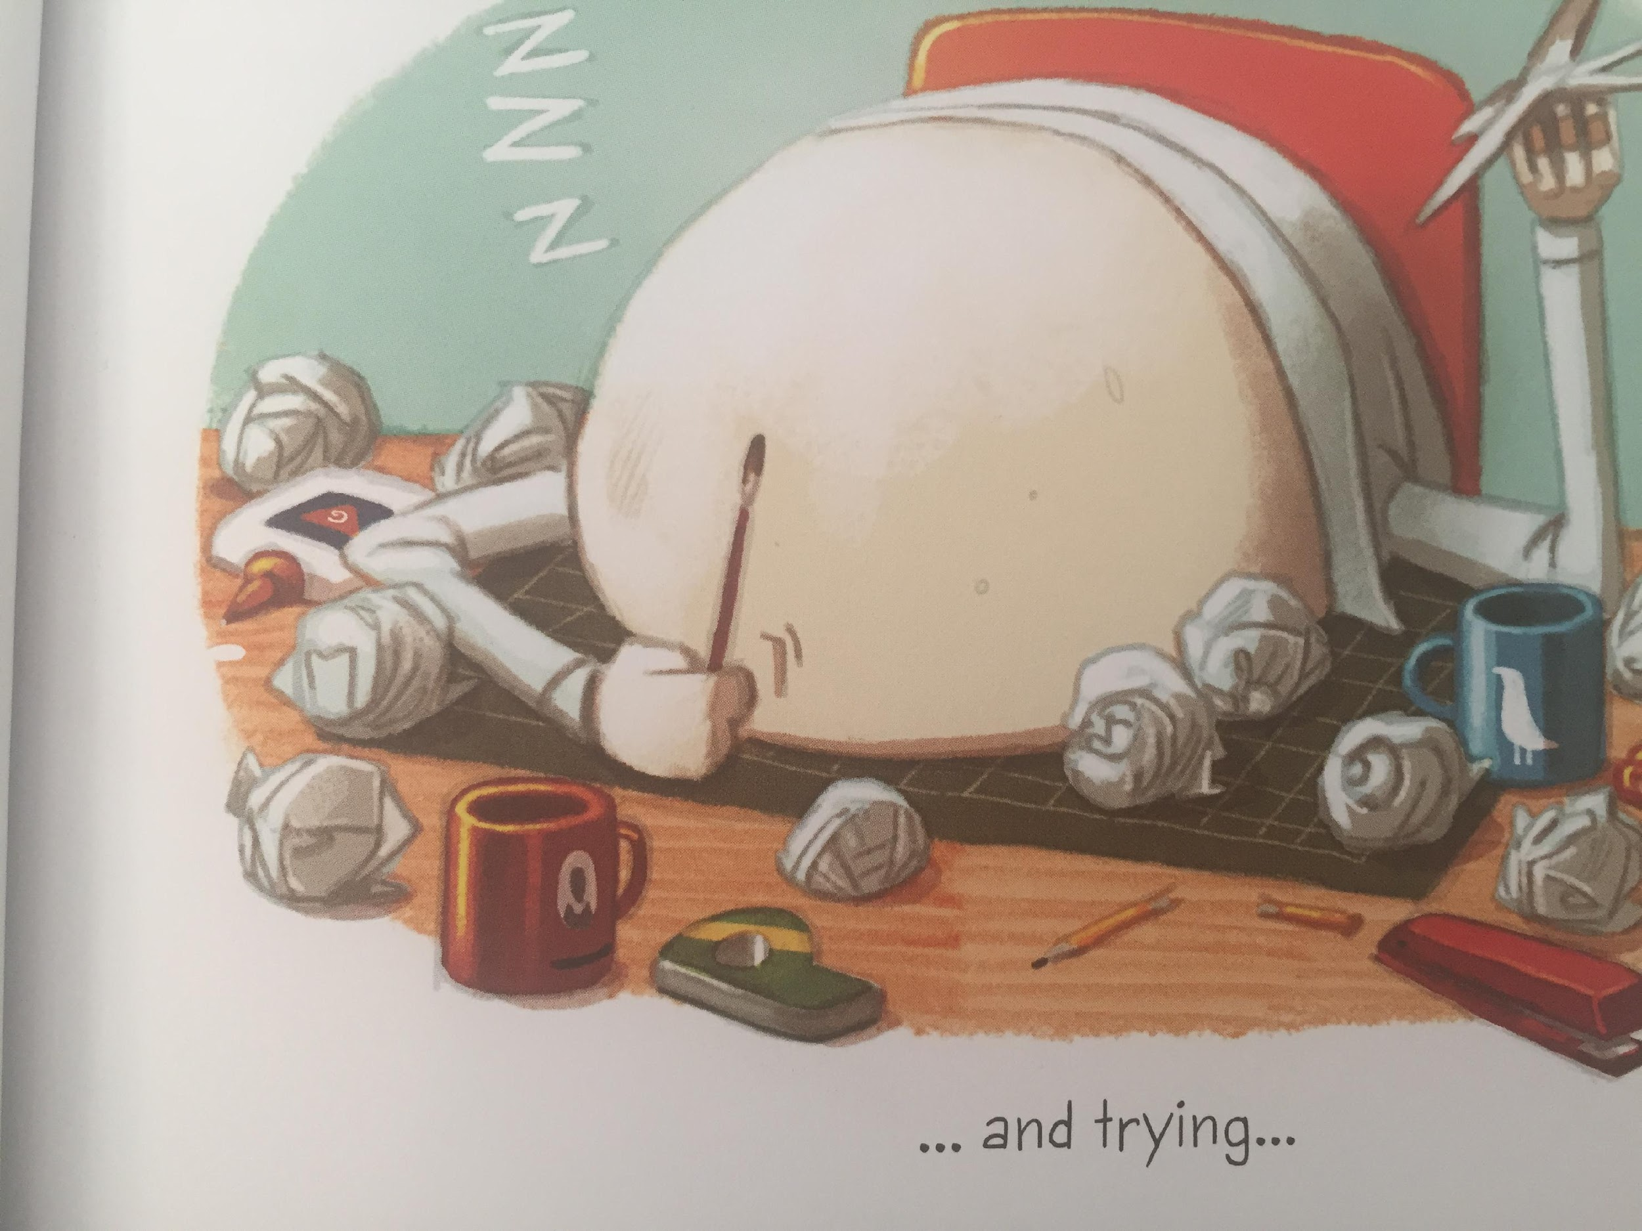
LI – to make links with my own life

Slide 20
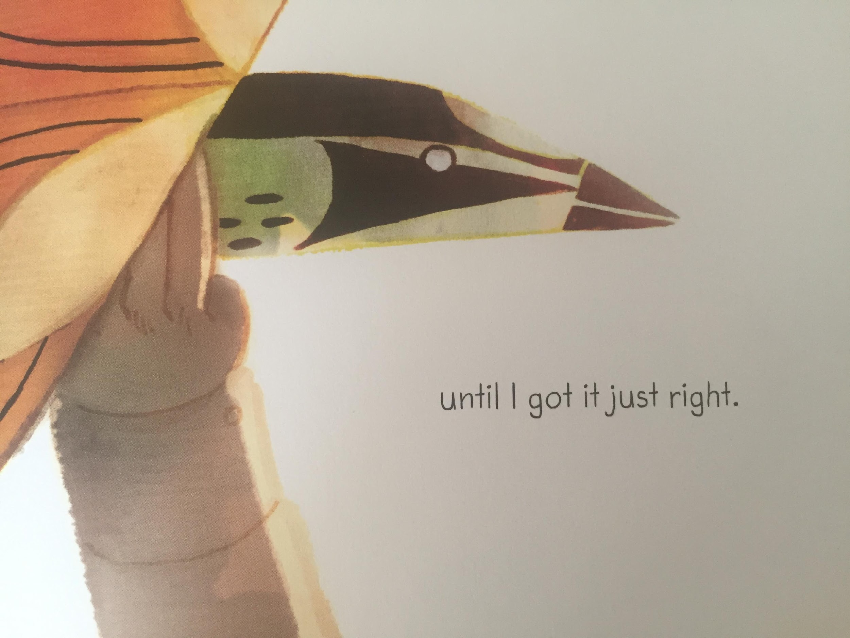
LI – to make links with my own life

Slide 21
What experience does this make you think of ?
This makes me think of ... because. ...

Slide 22
Thursday

Slide 23
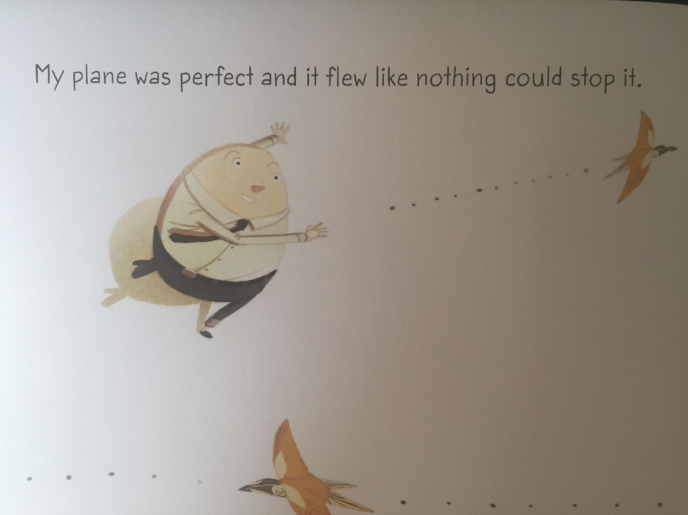

Slide 24
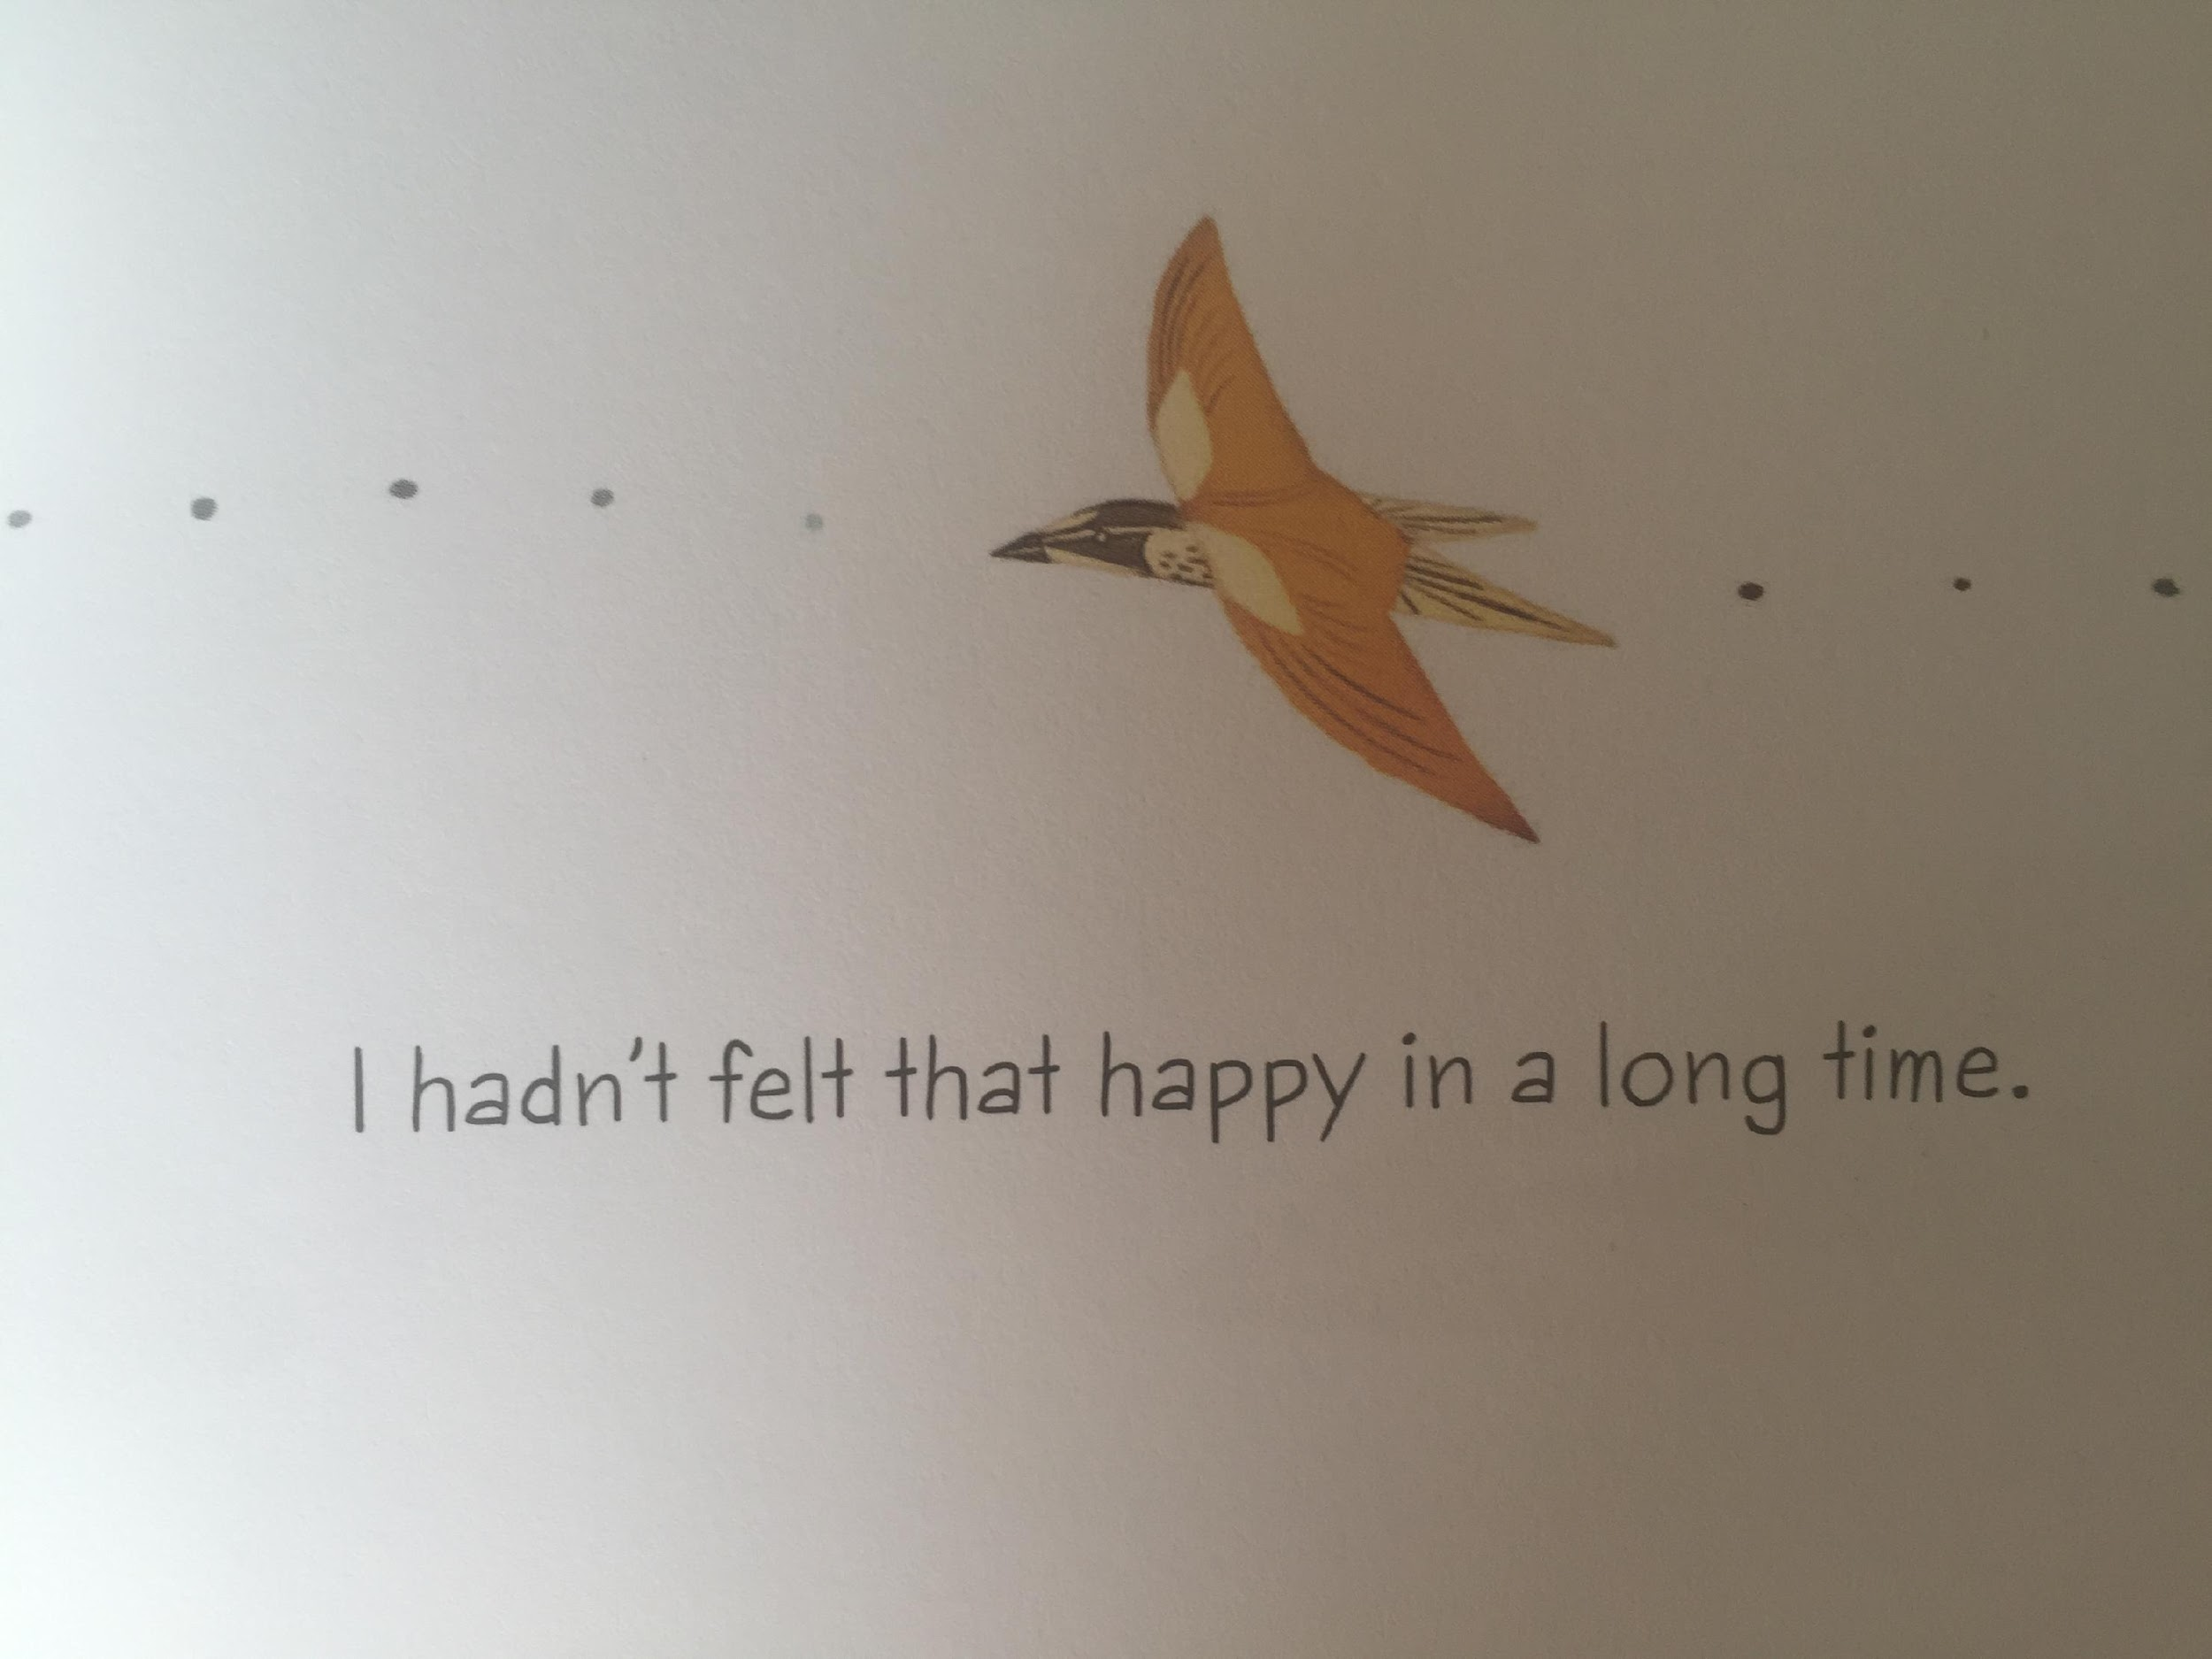
LI – to make links with my own life

Slide 25
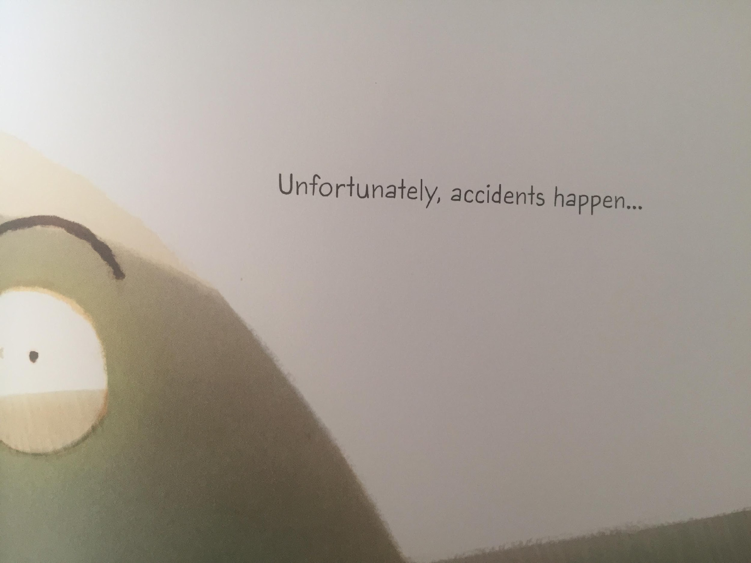
LI – to make links with my own life

Slide 26
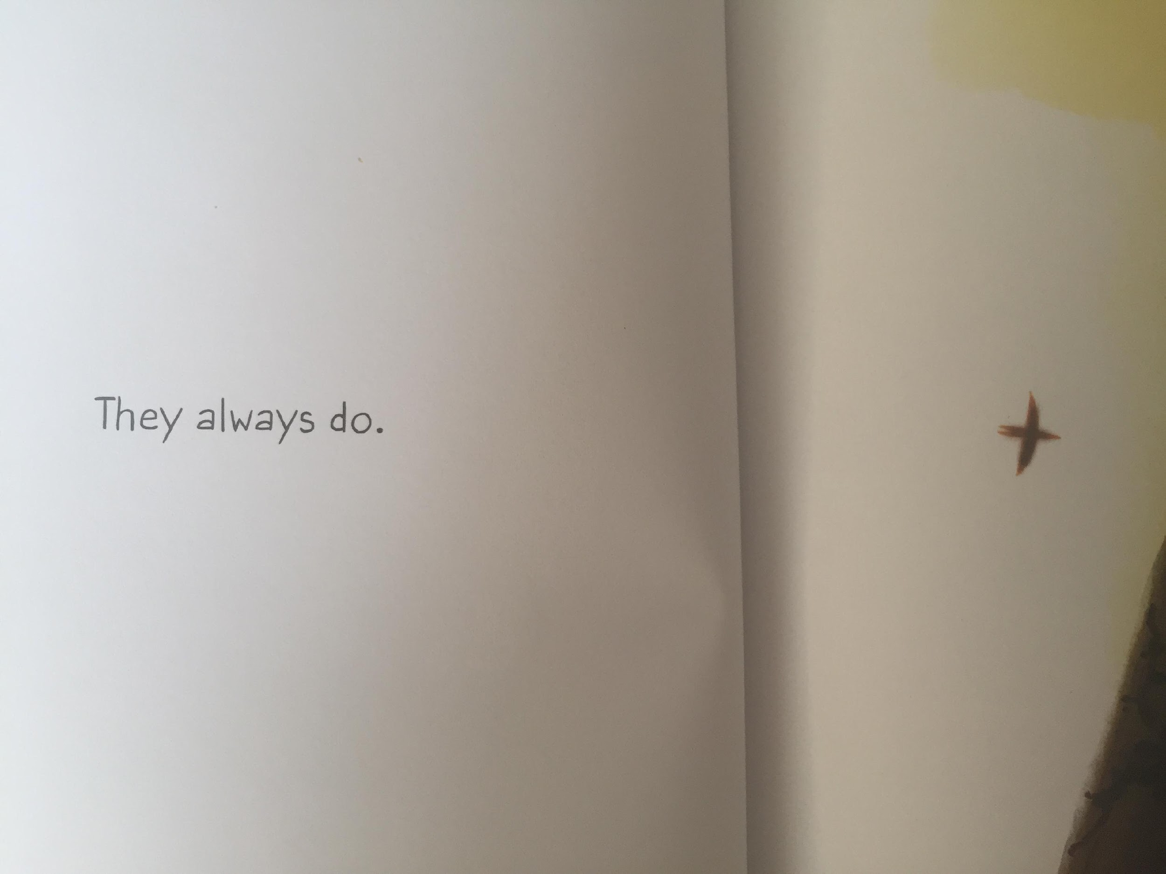
LI – to make links with my own life

Slide 27
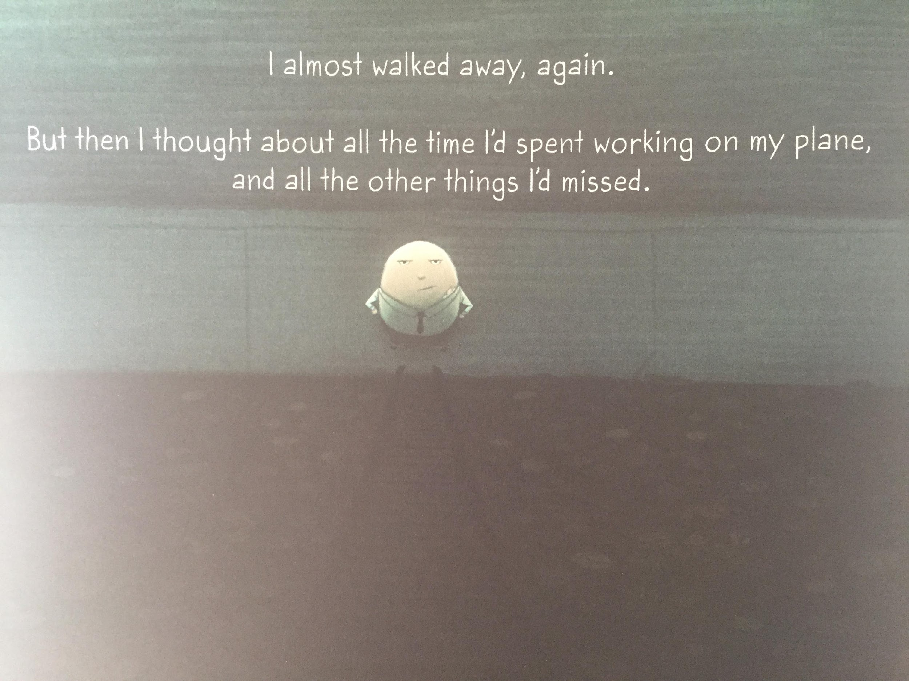

Slide 28
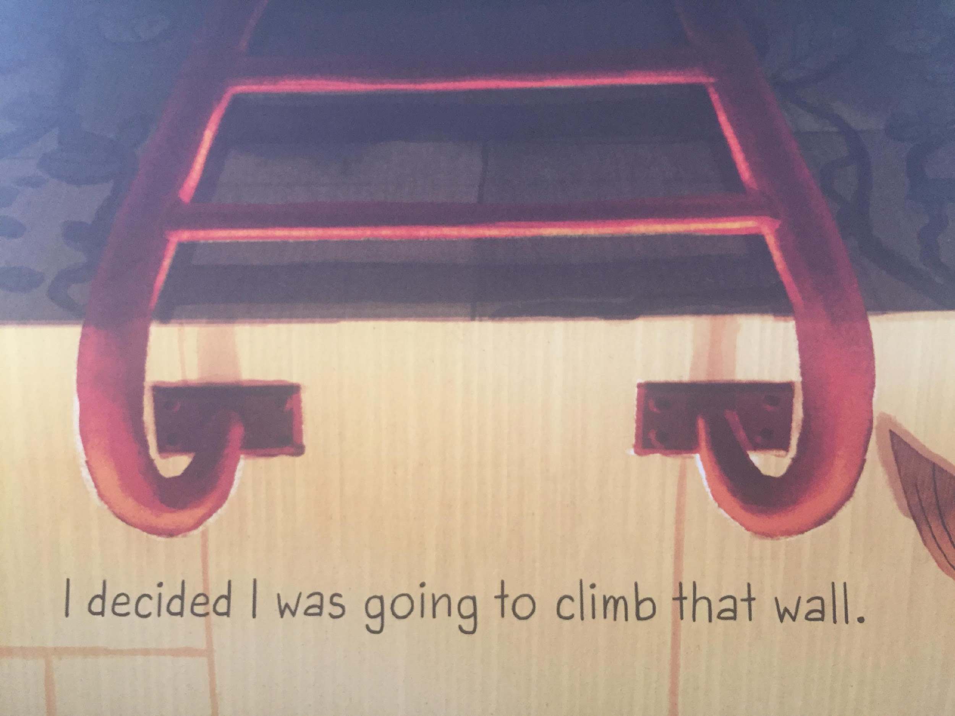
LI – to make links with my own life

Slide 29
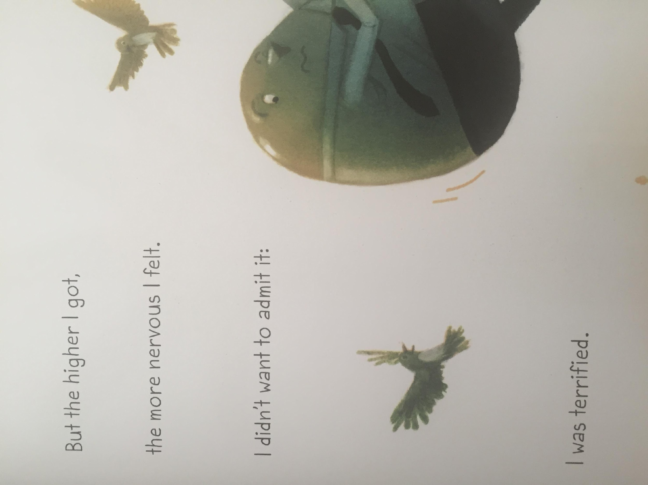

Slide 30
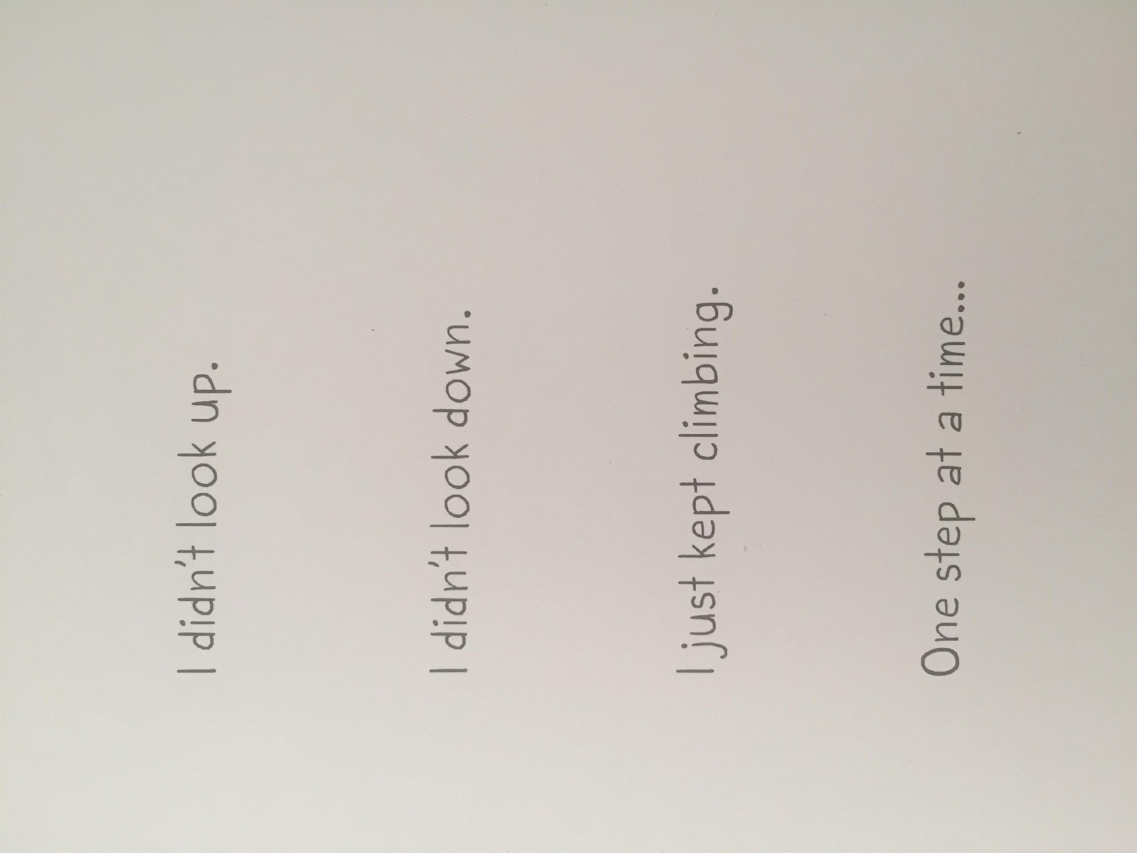
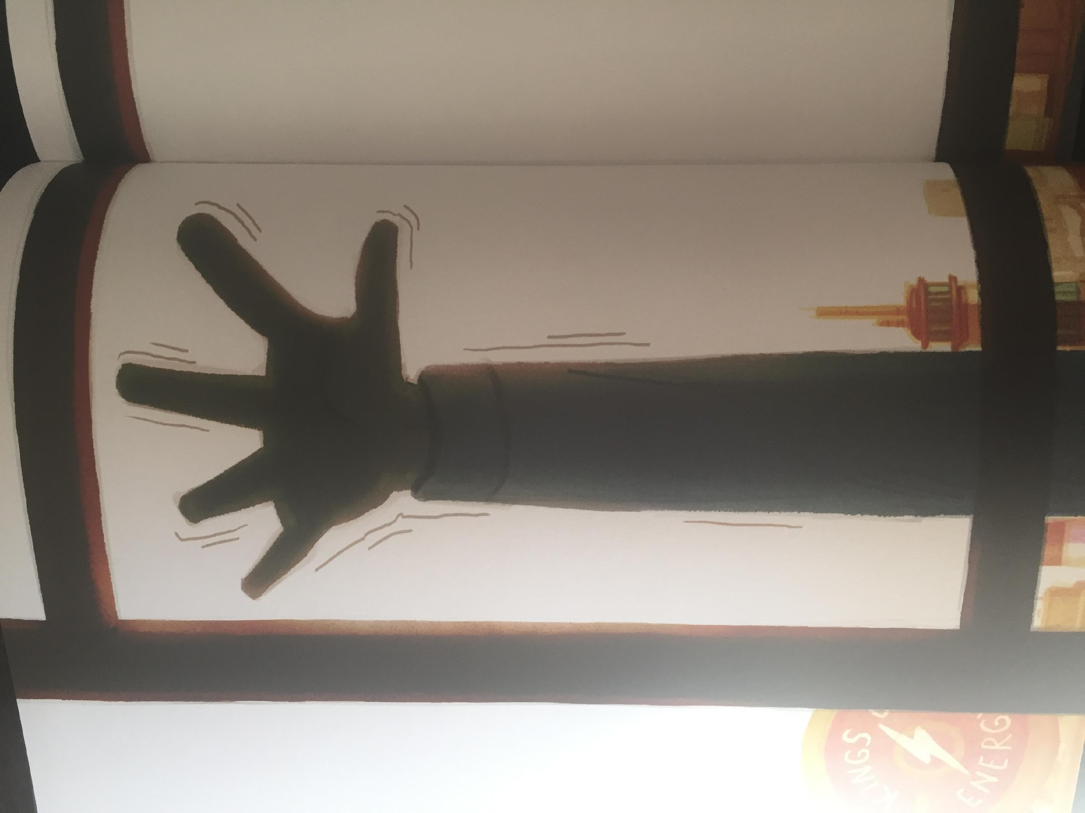
LI – to make links with my own life

Slide 31
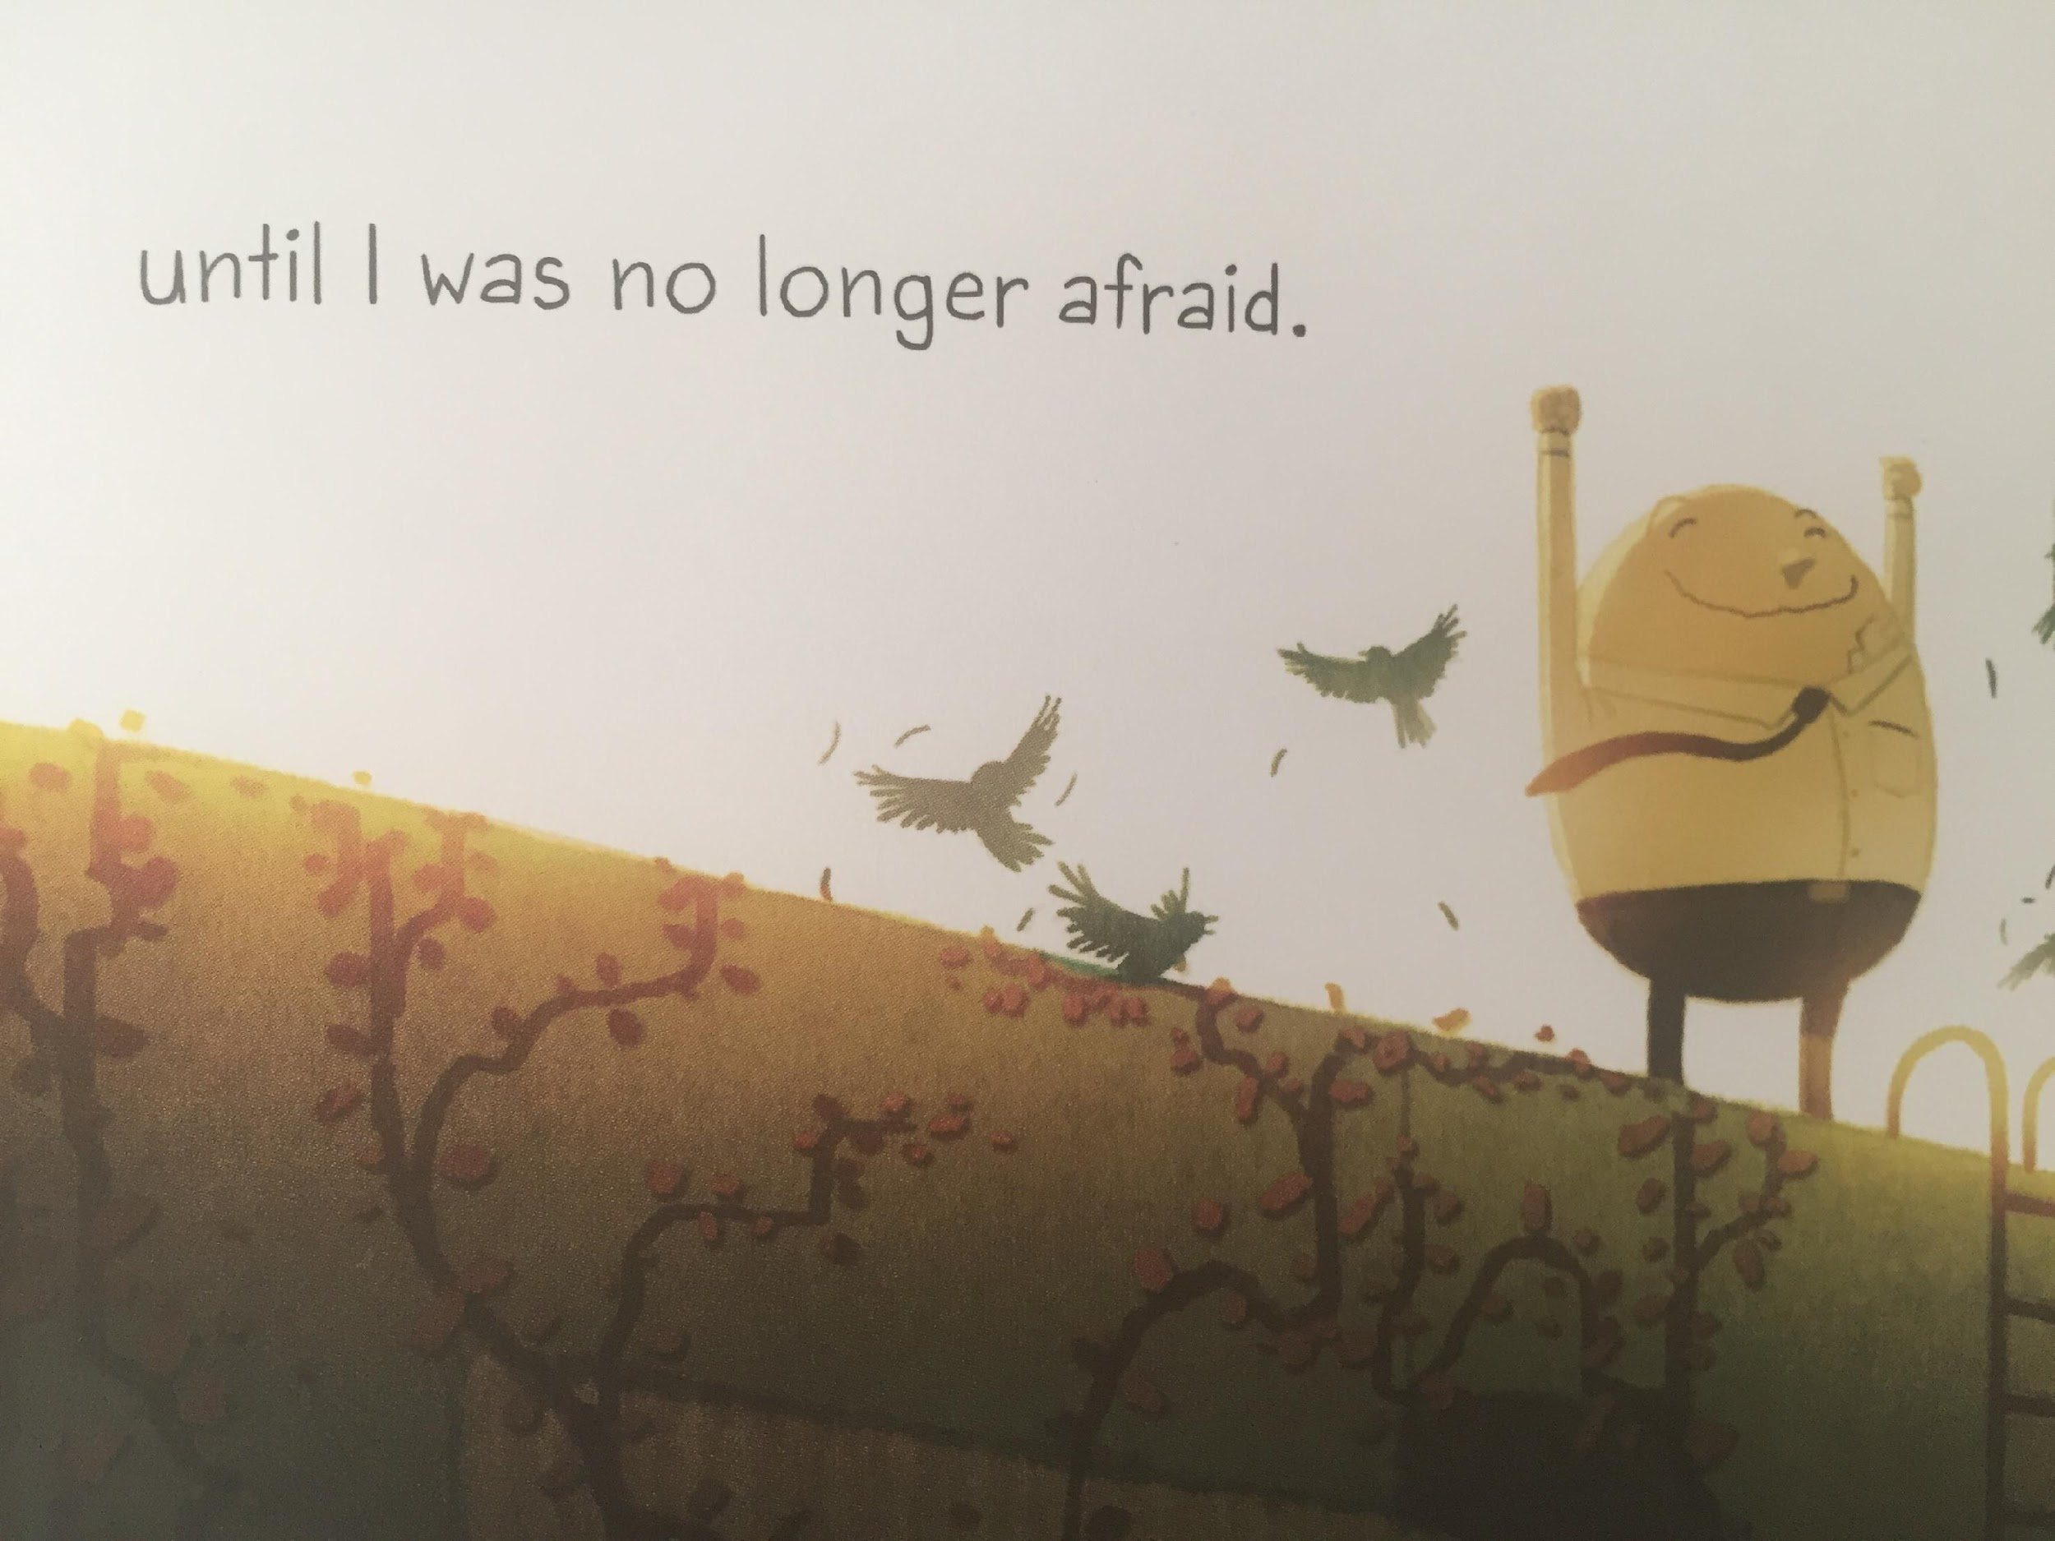

Slide 32
LI – to make links with my own life
Have you ever felt like this before?
This reminds me of ...

Slide 33
Friday
selfie

Slide 34
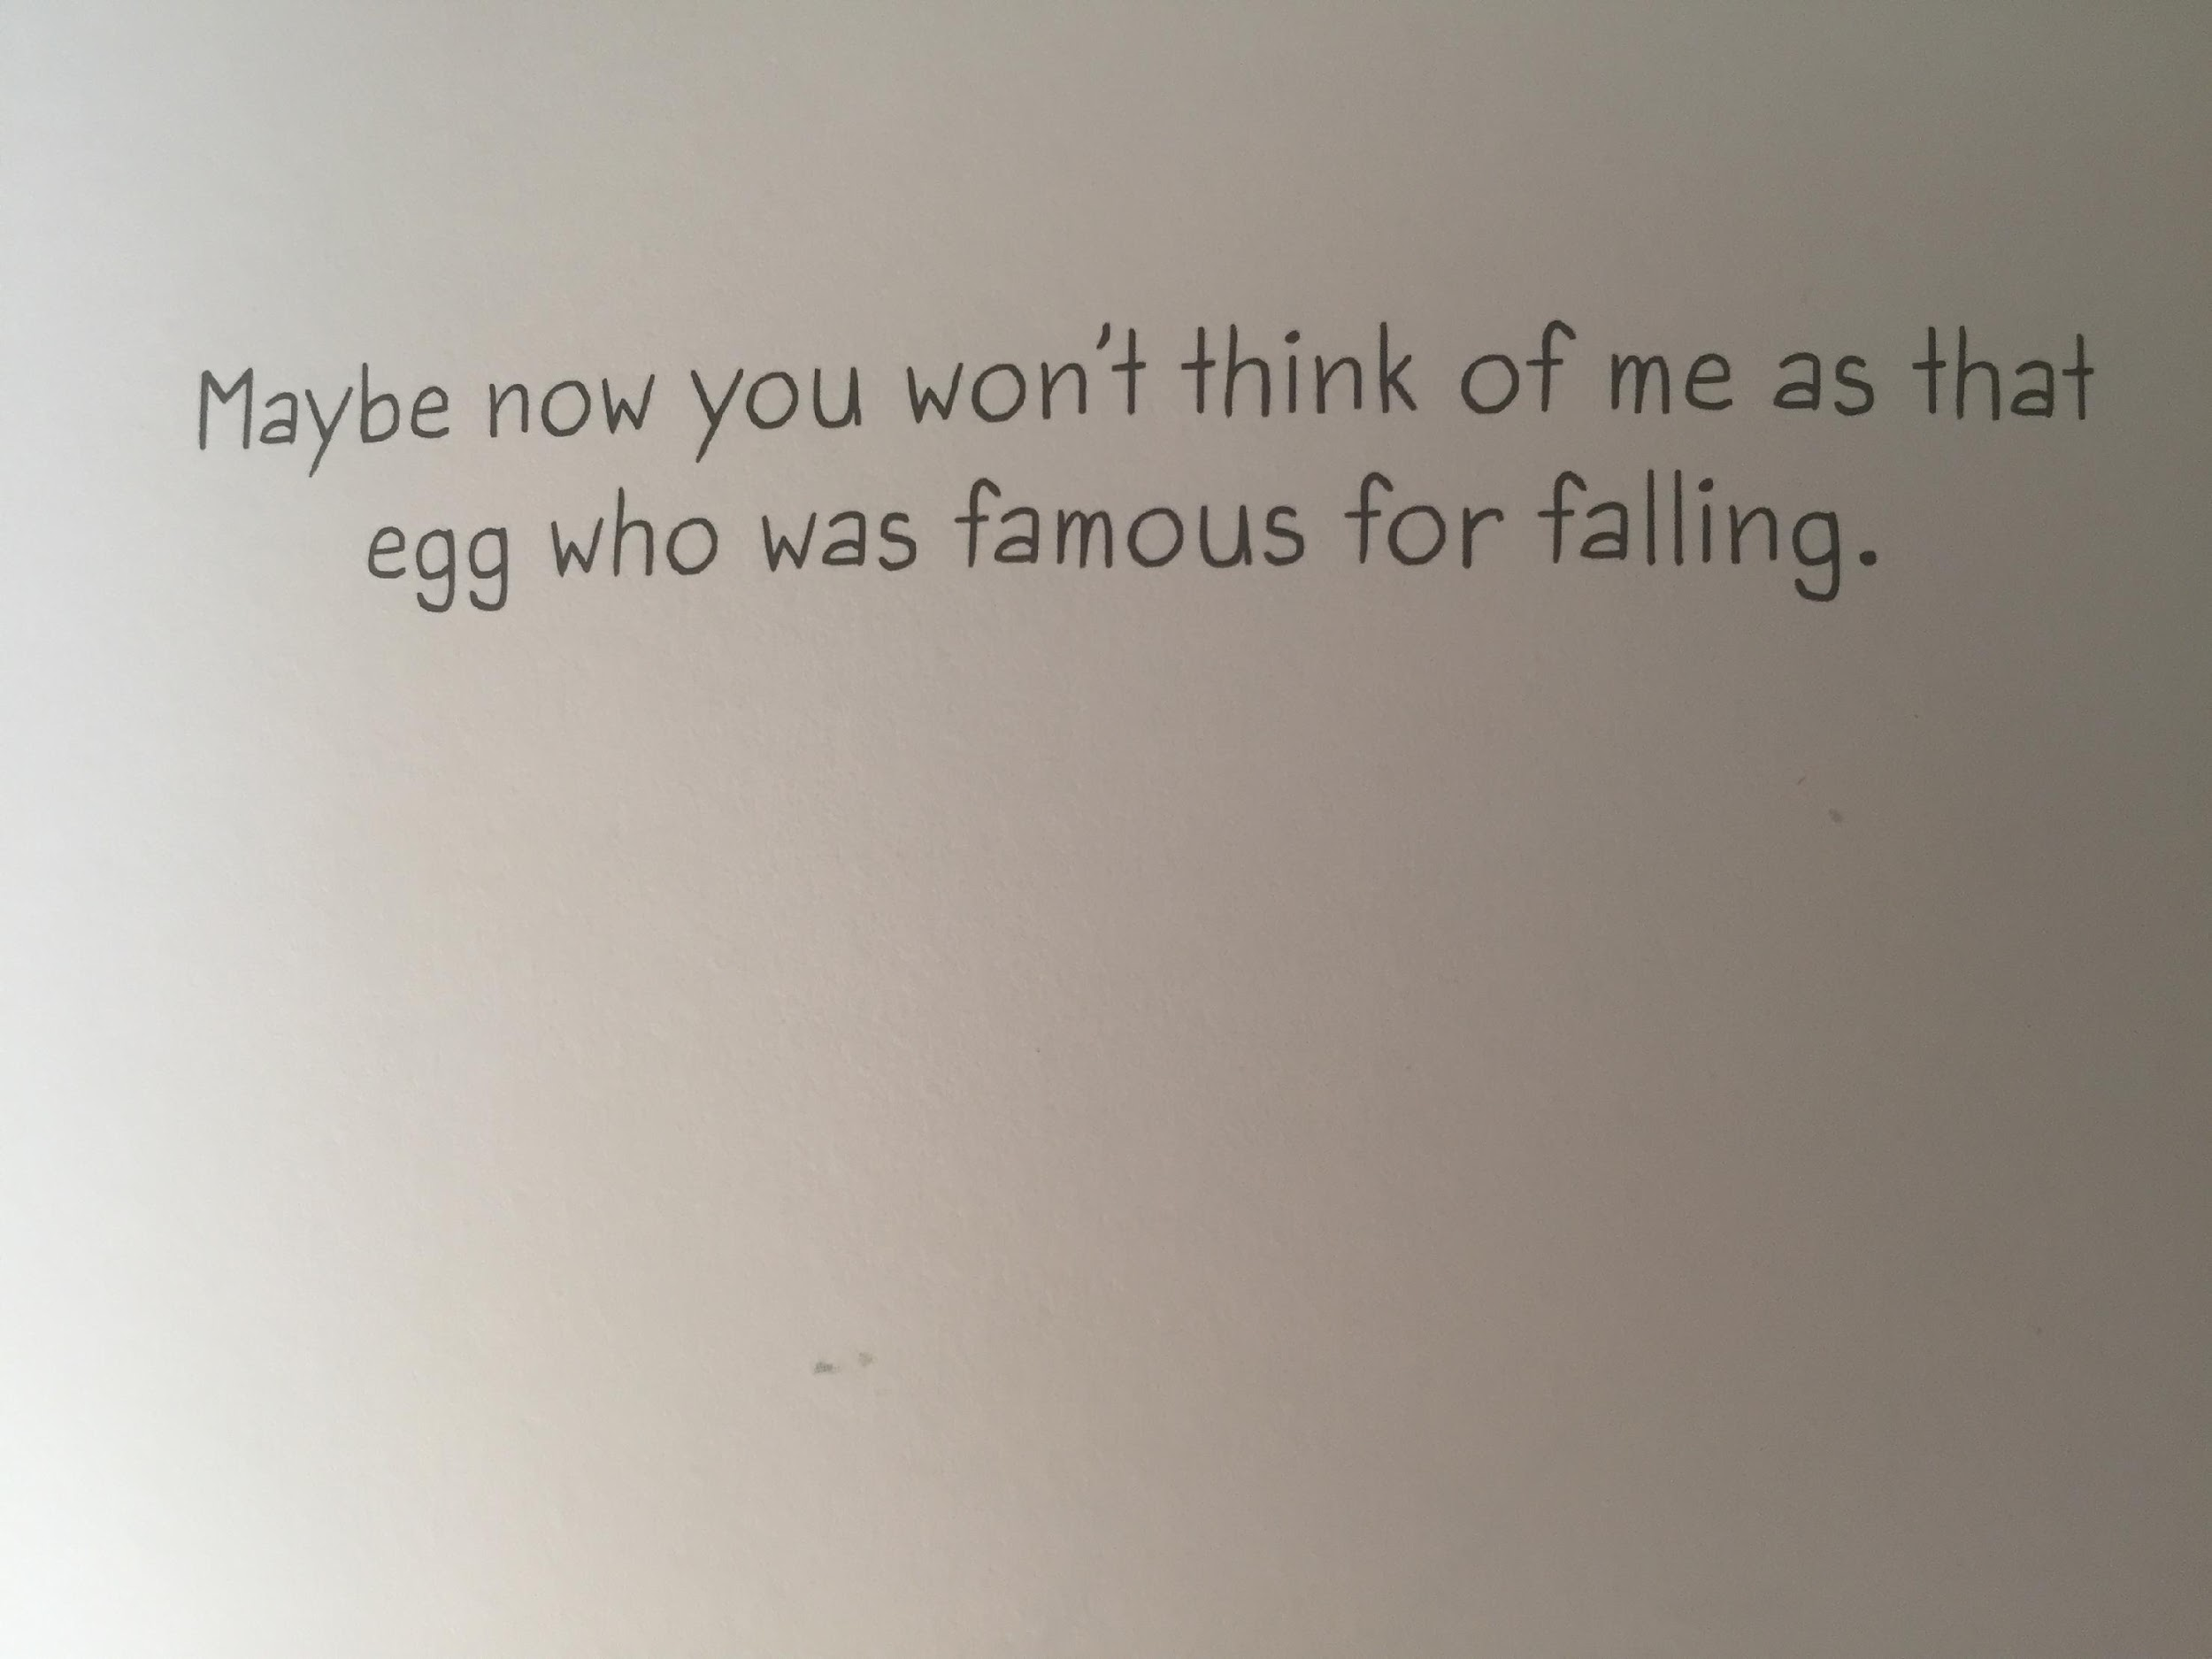

Slide 35
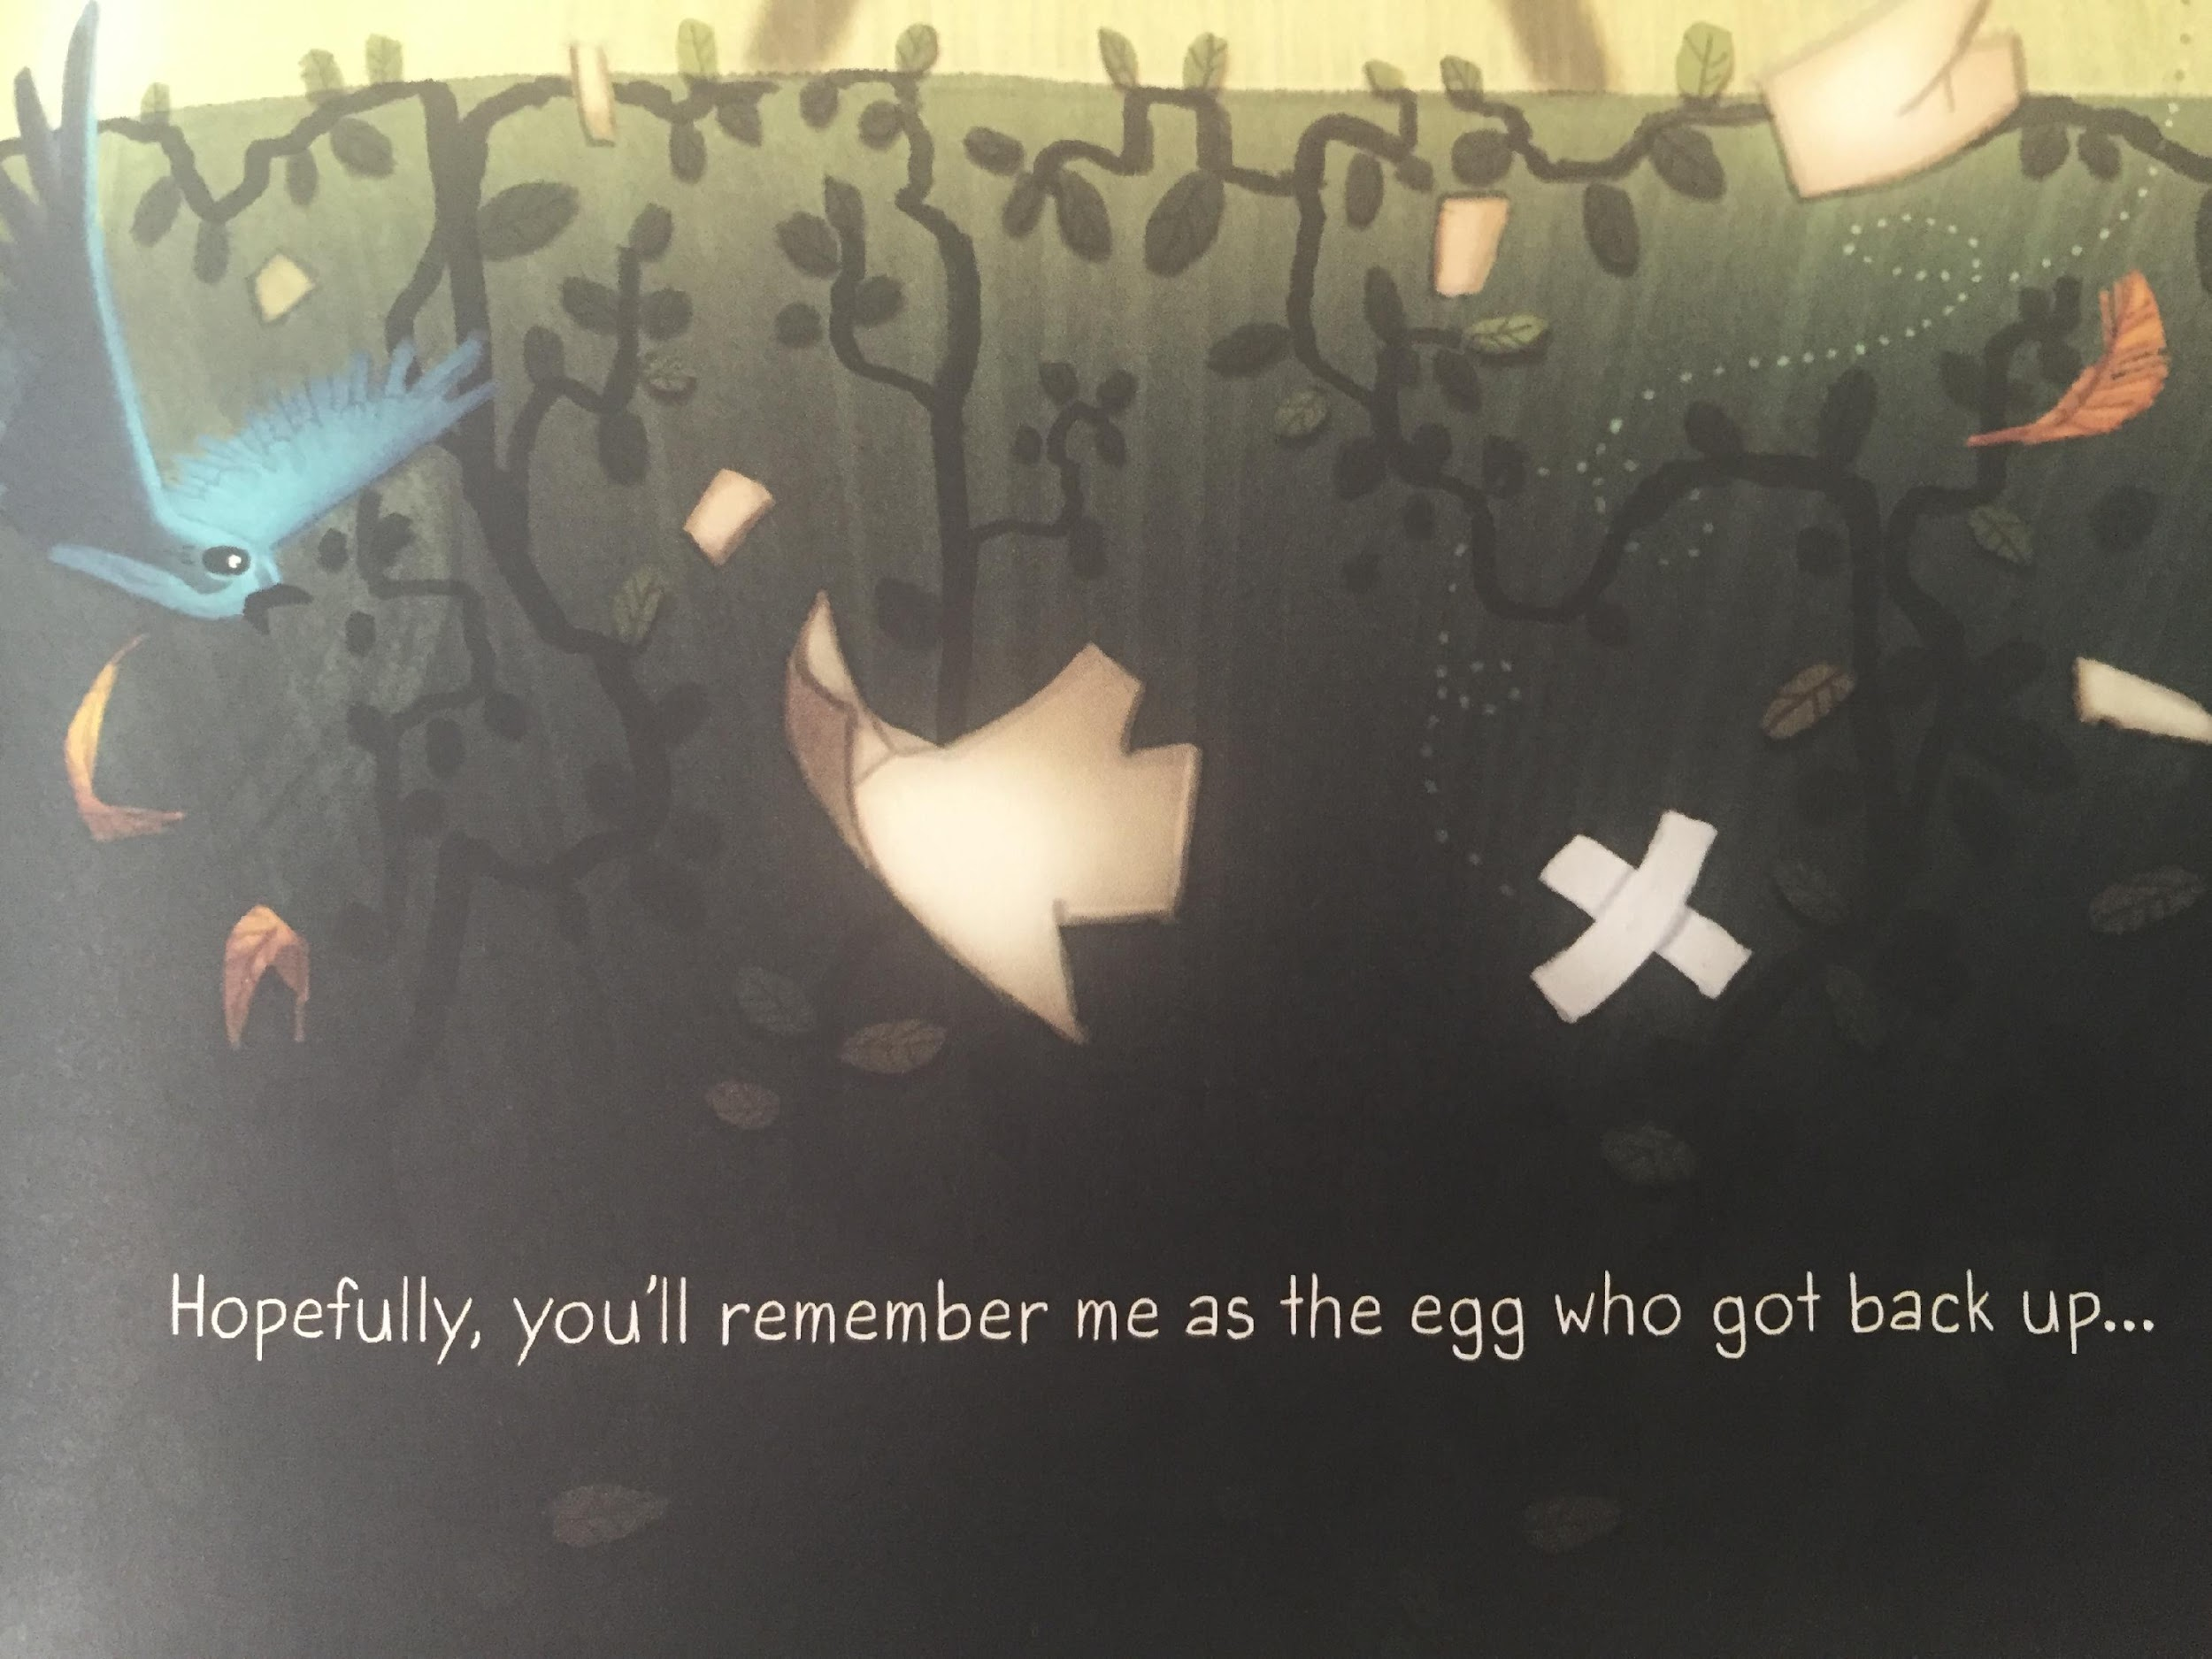
LI – to make links with my own life

Slide 36
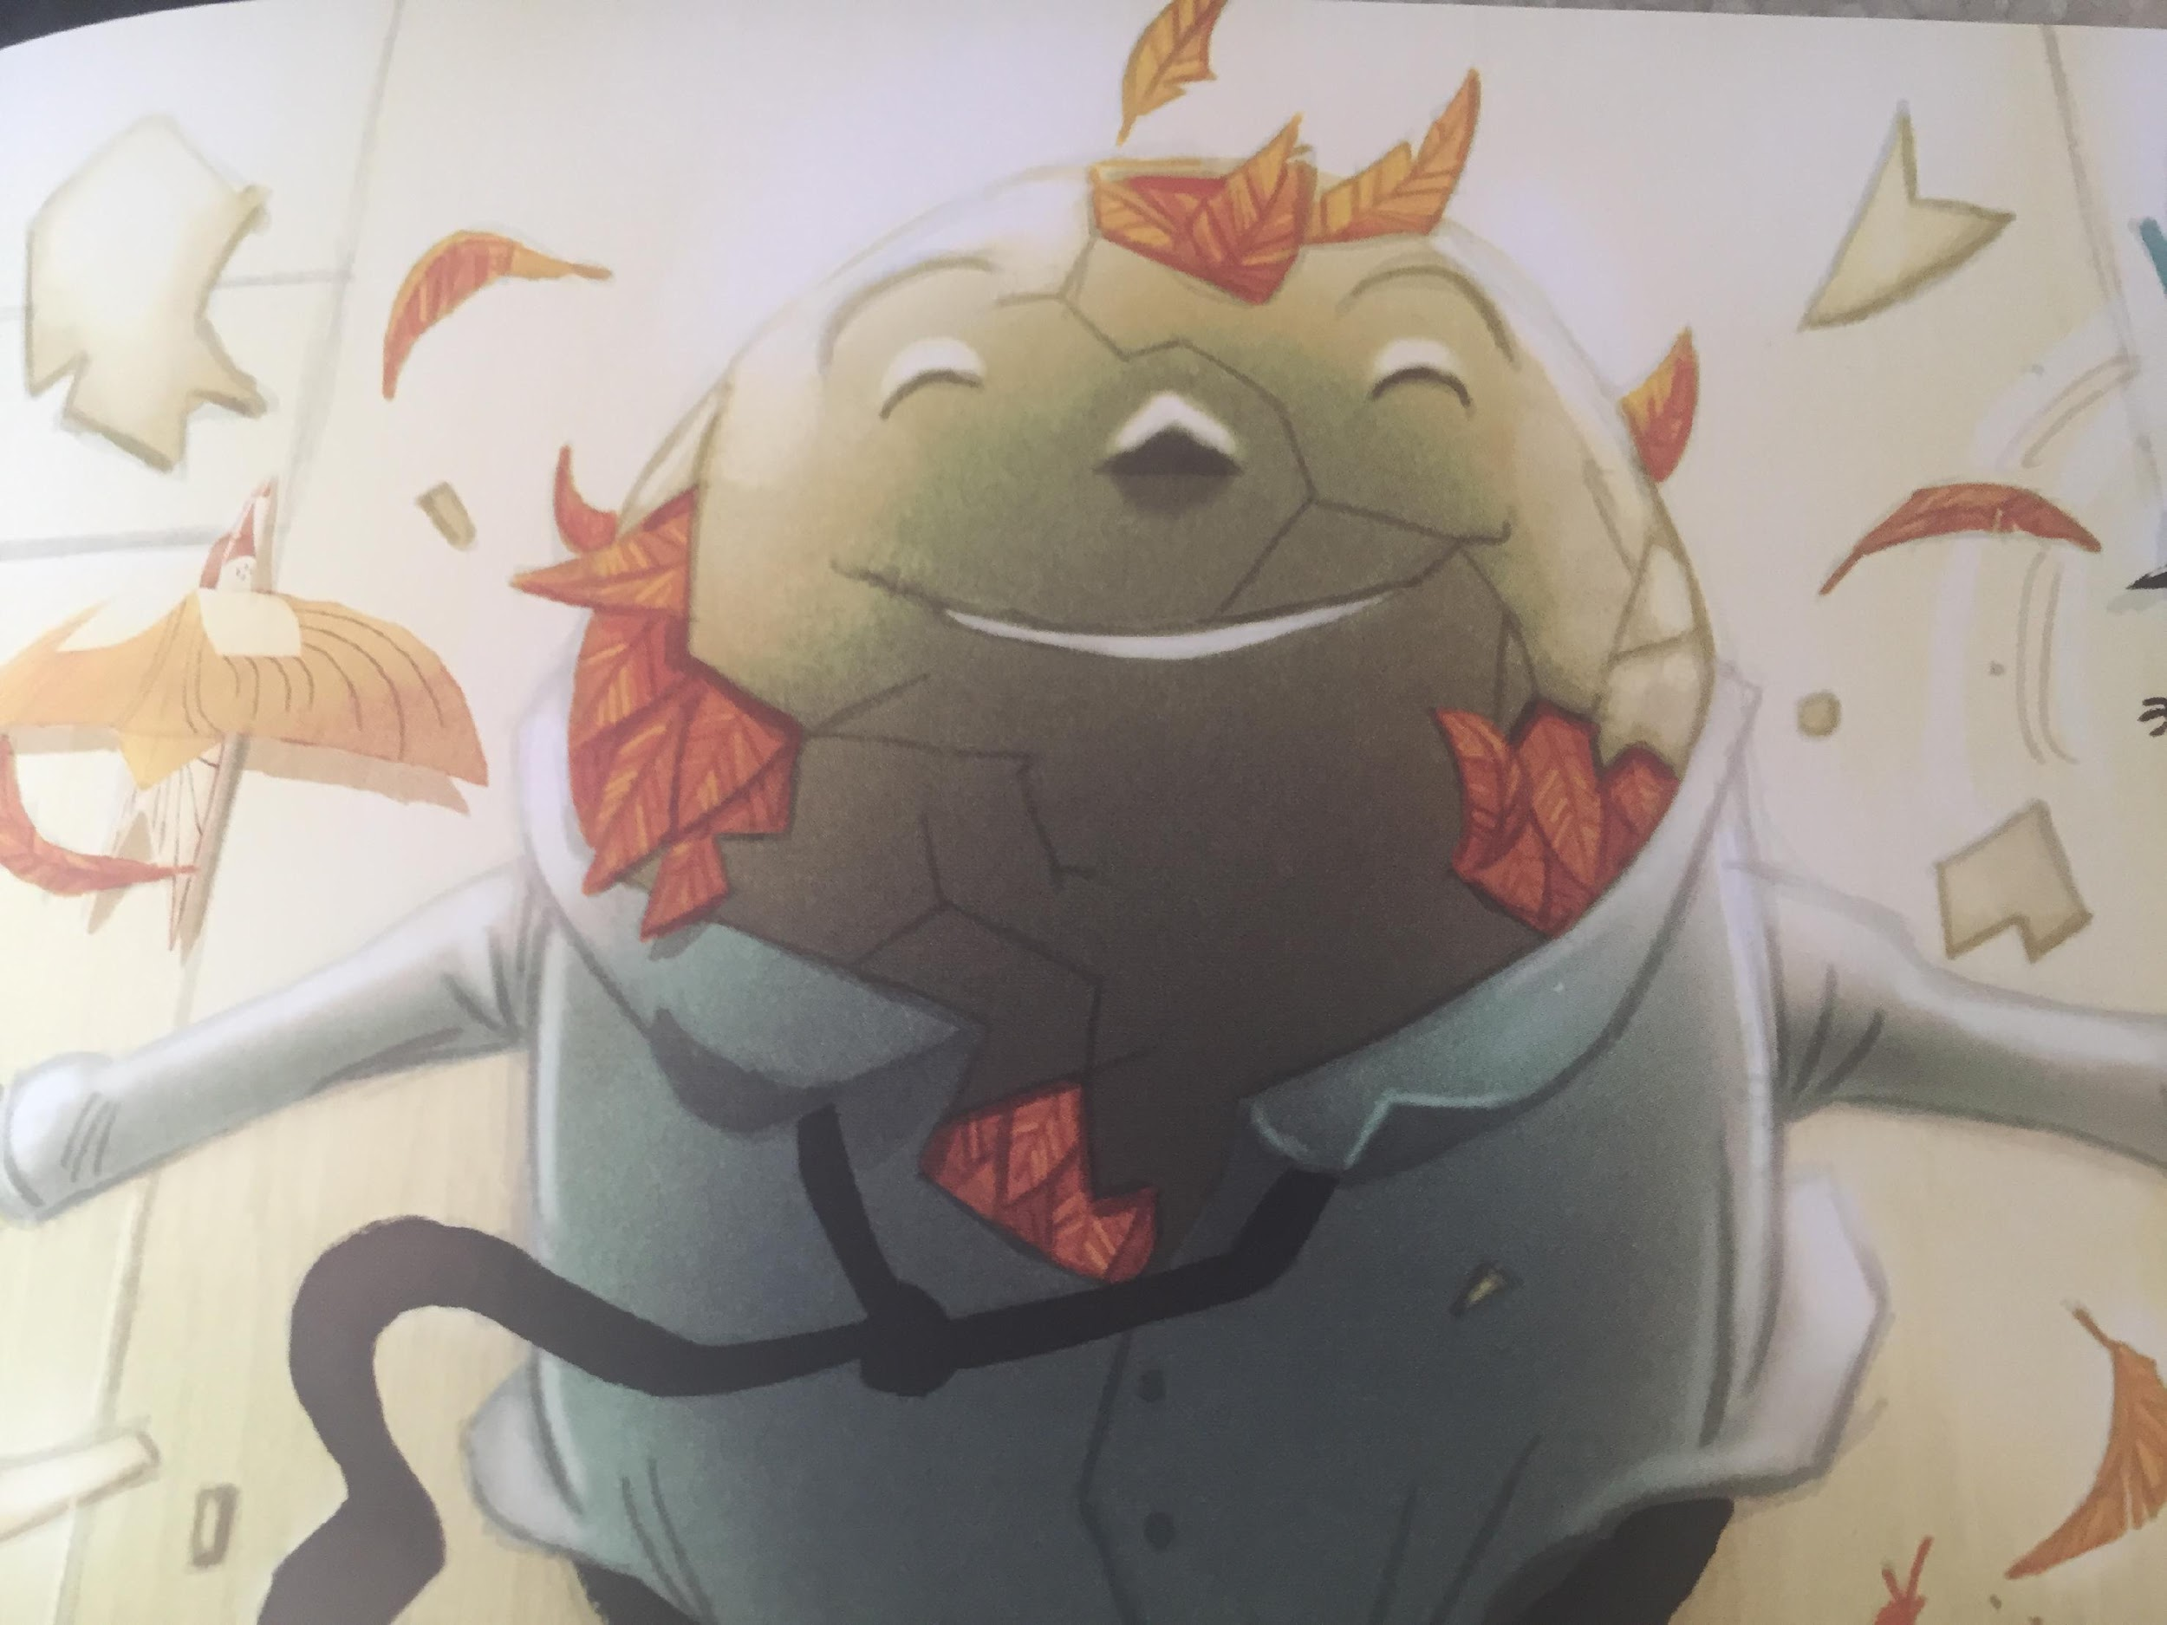

Slide 37
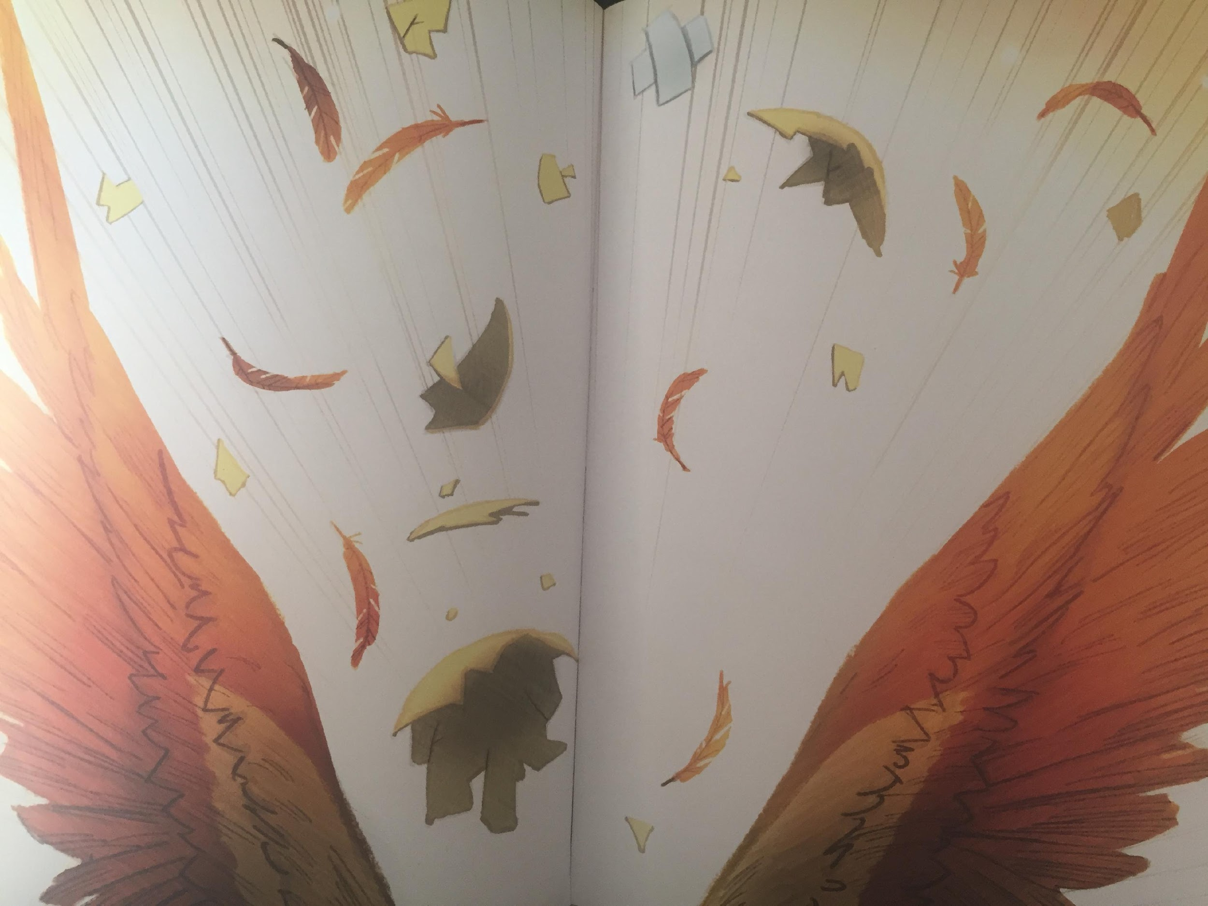
LI – to make links with my own life

Slide 38
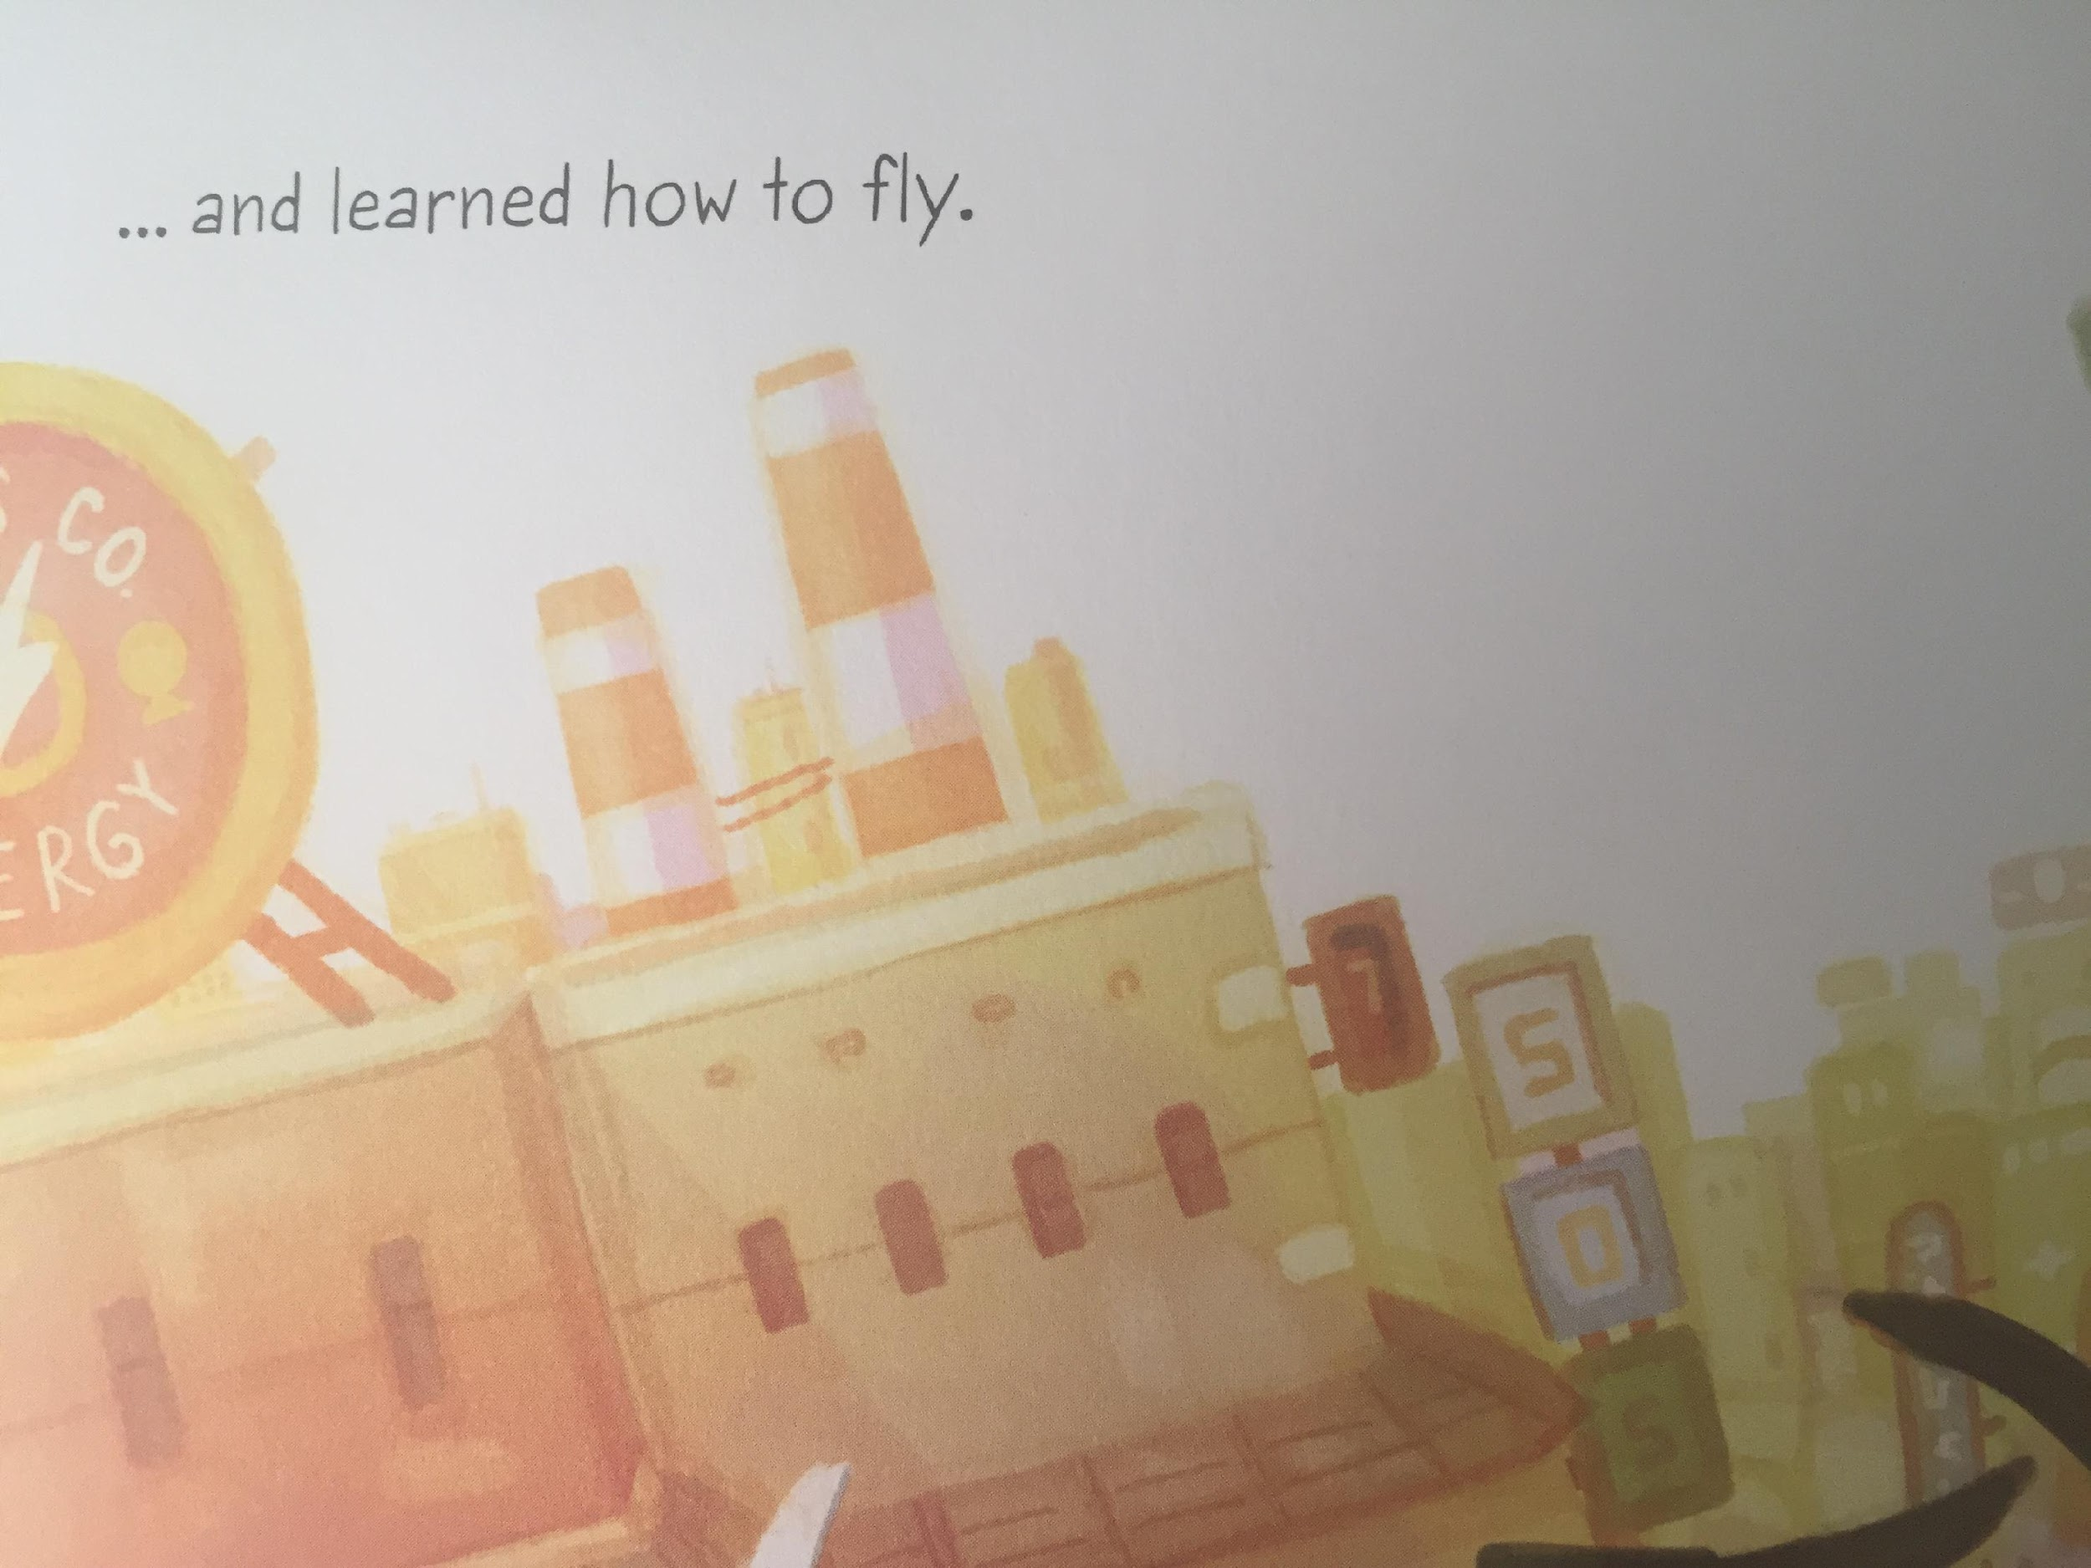

Slide 39


