Slide 1
TO COMPARE AND CONTRAST ARTISTS
This week we will be looking at the art of two artists and comparing and contrasting their work.
The artists that we will be looking at are Charlie Mackesy and Pablo Picasso.

Slide 2
PICASSO AND HIS ART
Picasso was a Spanish artist who revolutionised art through cubism.
Cubism involves different ways of seeing, or perceiving, the world around us. Picasso believed in the concept of relativity – he took into account both his observations and his memories when creating a Cubist image. He felt that we do not see an object from one angle or perspective, but rather from many angles selected by sight and movement. As a result of this belief, Cubism became about how to see an object or figure rather than what the artist was looking at.

Slide 3
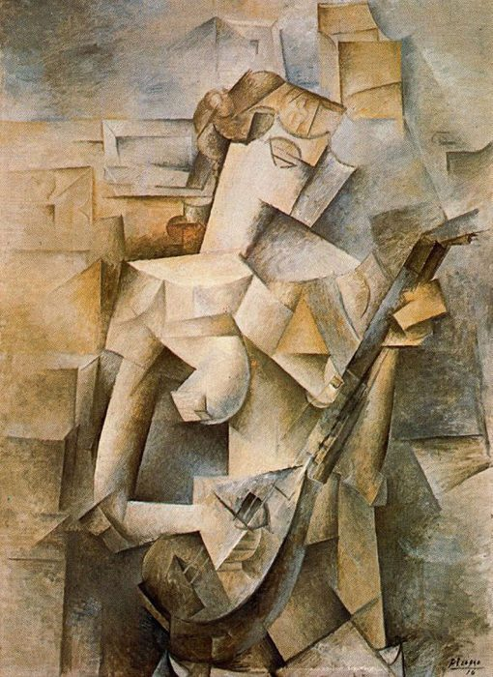
GIRL WITH MANDOLIN BY PICASSO
What do you notice about this picture?

Slide 4
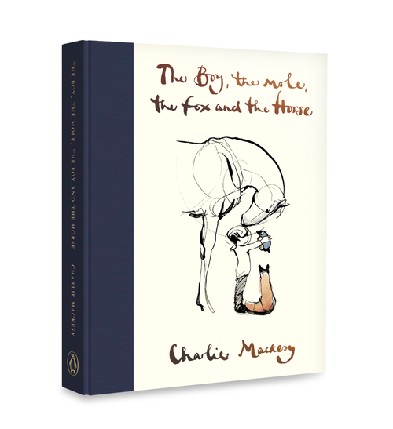

Slide 5
CHARLIE MACKESY
Charlie Mackey was born in England in 1962 in England.
Charlie Mackesy's Art work have been exhibited throughout the world and are in many major art collections.
He uses continuous lines to create his images often with ink.
Charlie Mackesy is a British artist known for his realism art style
Realism artists depict the real world exactly as it appears. They create everyday subjects and people as it appears in nature.
Charlie Mackesy uses bold line drawing to create his drawings.

Slide 6
LINE DRAWINGS
Line art or line drawing is any image that consists of distinct straight or curved lines placed against a background, without gradations in shade or hue to represent two-dimensional or three-dimensional objects. Line art can use lines of different colours, although line art is usually monochromatic.

Slide 7
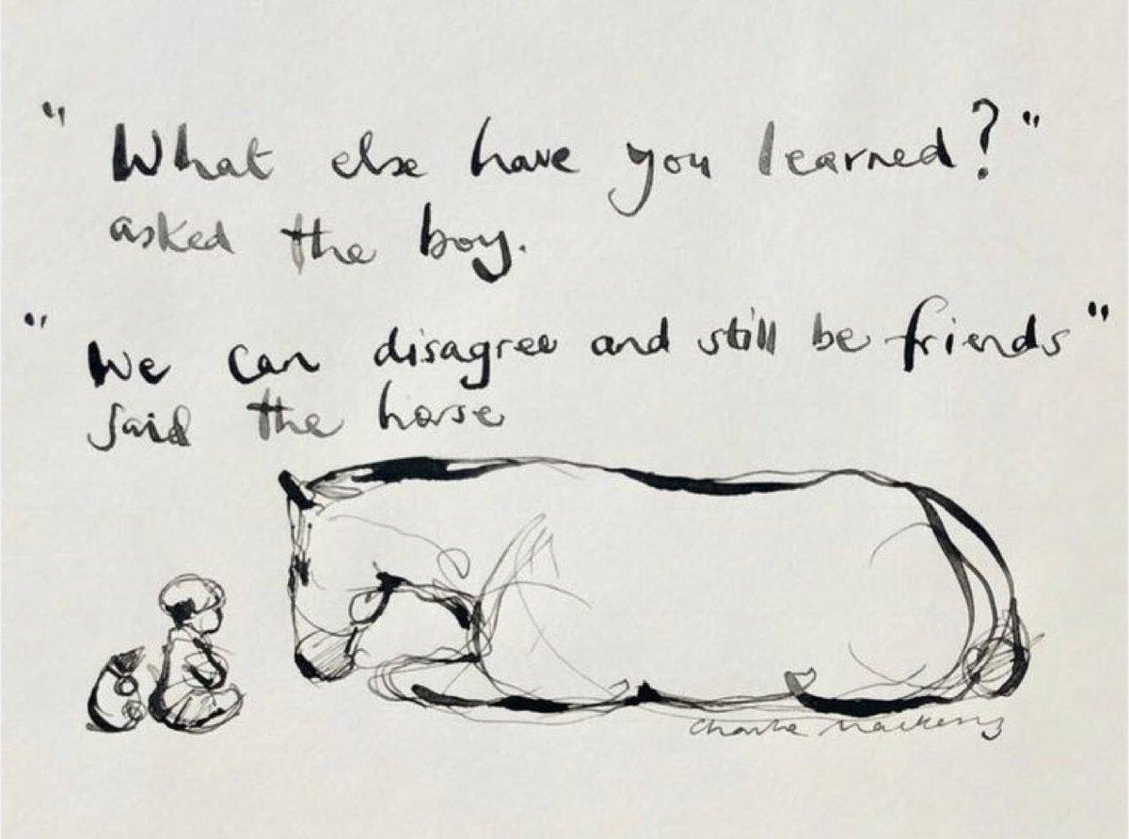
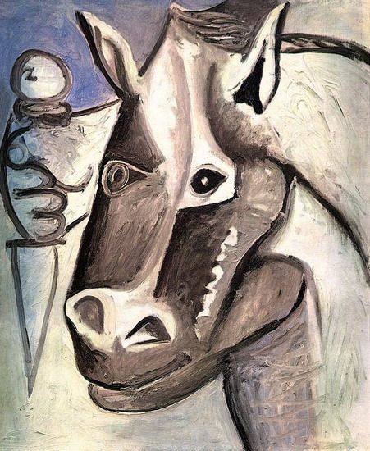
LOOK AT THE TWO DRAWINGS AND DISCUSS WHO THE ARTIST IS.
CAN YOU EXPLAIN WHY? WHAT ARE THE SIMILARITIES AND DIFFERENCES?
Picasso or Mackesy ?
Picasso or Mackesy?

Slide 8

MOOD BOARDS
Now we have looked at and discussed the works of Picasso and Mackesy let us think about Mood boards.
Mood boards are also known as inspiration boards:
They are used as a brainstorm for Artists and Designers.
They are compiled of things that inspire you
These could be drawings, paintings, cuttings, objects or anything really
They Help you paint, draw and design
Your mood board can contain images and annotated notes on: themes you’ve noticed, materials used, colours and what they could represent, sizing and placing of objects.
Let’s look at some examples on the next few slides…

Slide 9
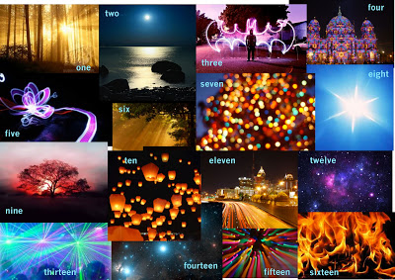
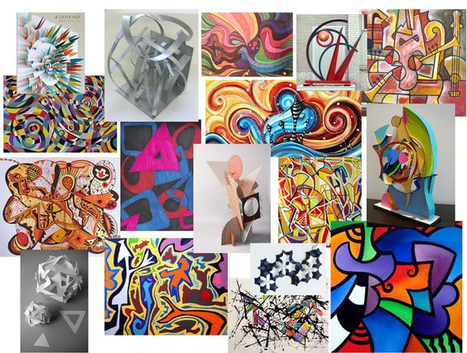
WHAT CAN YOU SEE?

Slide 10
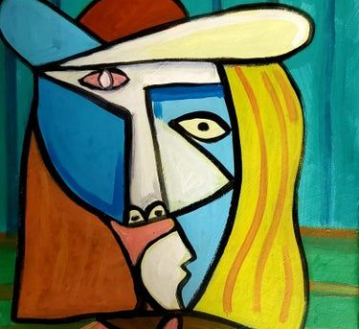
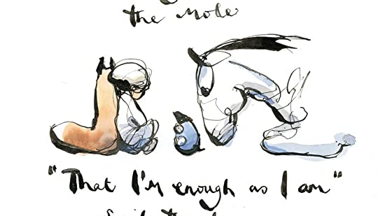
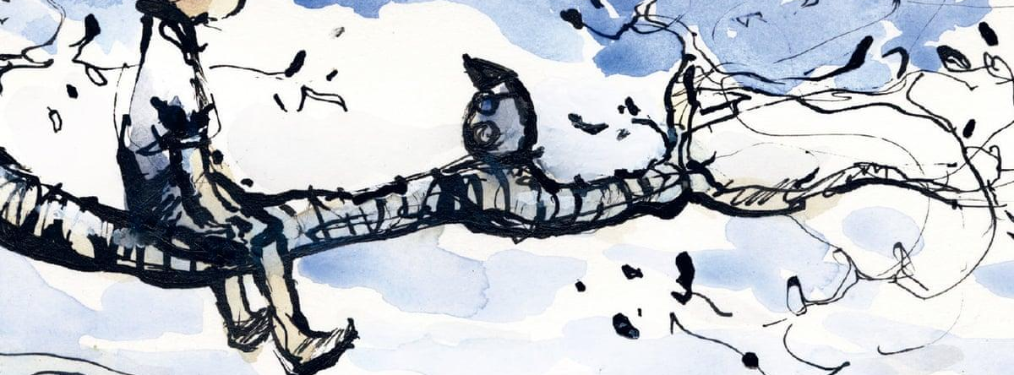

Slide 11
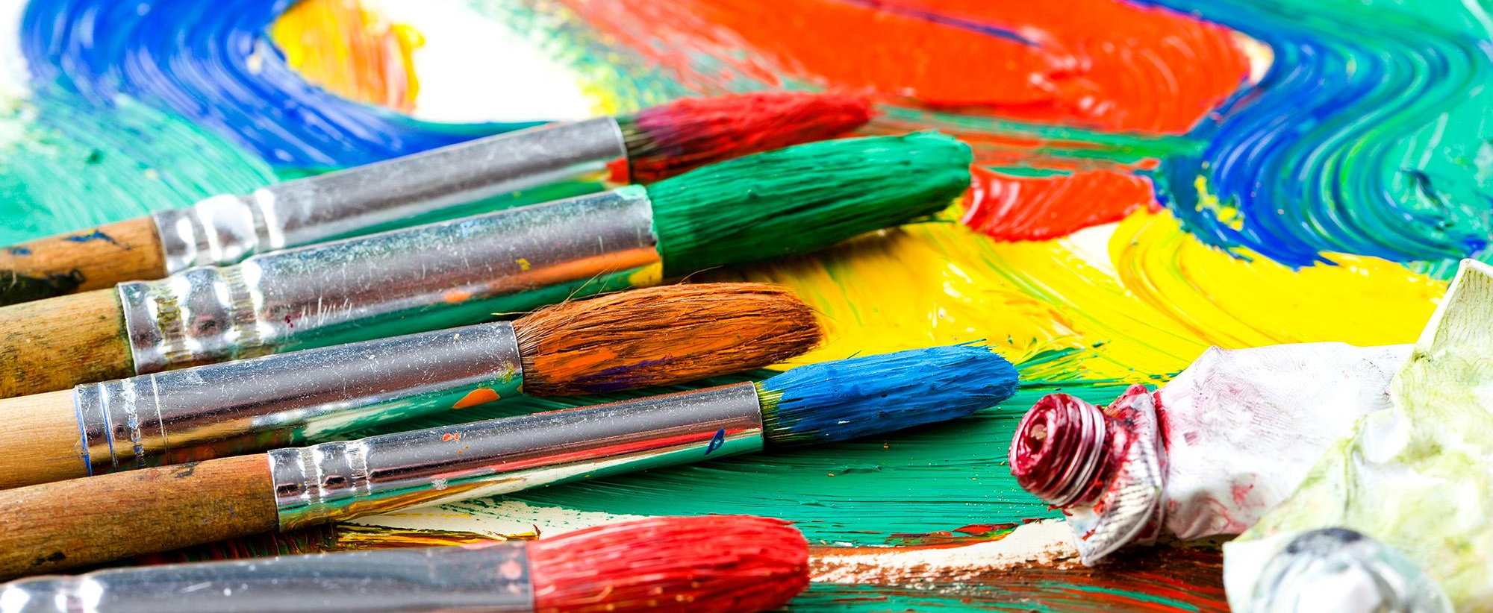
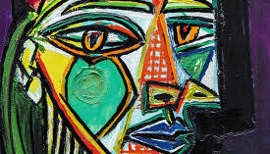
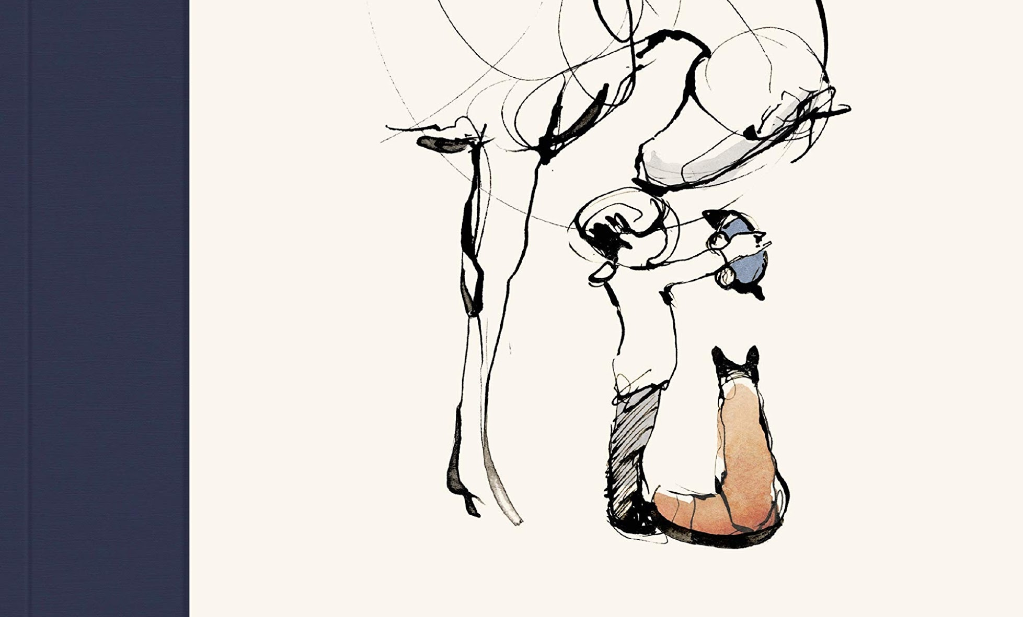
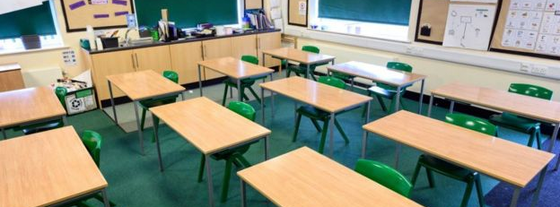

Slide 12

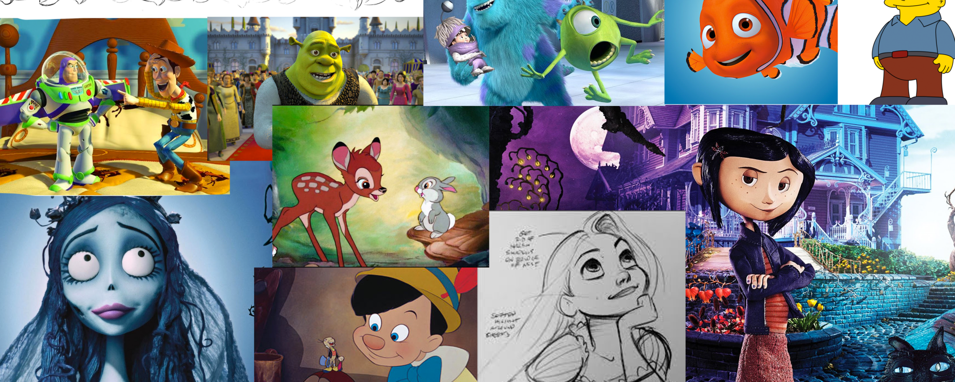
NOW OVER TO YOU TO DESIGN YOUR OWN MOOD BOARD

