Slide 1
LI: TO EXPLORE THE THEME OF A NEW TEXT
Generate ideas about what the book is about
Understand the purpose of the book
Identify your favourite line from the book, giving justifications.

Slide 2
On a sheet of paper answer these six questions. You will share your reflections with the class on Friday.
Who is the book for?
What is it about?
Why was it written?
What is the purpose?
What is the theme of the book?
Why are the messages important and why do you think it is our core text?

Slide 3
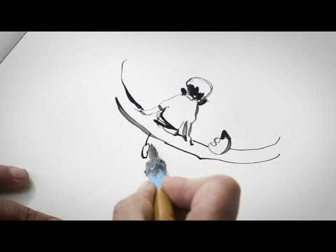
Watch this video

Slide 4
On the next slide you have a selection of lines and quotes from the book think carefully about which are your favourites and then try and whittle it down to just one favourite line.
On your sheet, as a reflection, you will write an explanation as to why it is your favourite.

Slide 5


