Slide 1
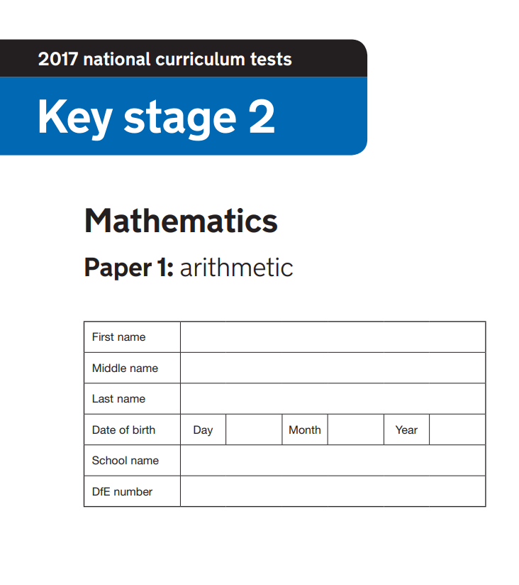


Thursday 22nd February, 2024
Year 6 SATs Workshop -
Mathematics

Slide 2
What are the SATS tests?
•The end of KS2 assessments are sometimes informally referred to as ‘SATS’.
•SATS week across the country begins on 13th May 2024
•Pupils will complete test papers in some of the areas that have to be assessed. Other areas, like writing, are assessed using evidence collected by the teacher over a longer period of time.
•Pupils will complete SATS test papers in:
- Reading
- Grammar, Punctuation & Vocabulary
- Spelling
- Arithmetic
- Mathematical Reasoning – 2 papers

Slide 3
Mathematics - Wednesday 15th and Thursday 16th May
Children will sit three tests: paper 1, paper 2 and paper 3.
Paper 1 is for arithmetic lasting for 30 minutes, covering calculation methods for all operations, including: addition, subtraction, multiplication, division, including order of operations requiring BIDMAS), percentages of amounts and calculating with decimals and fractions.
Questions gradually increase in difficulty. Not all children will be expected to access some of the more difficult questions later in the paper.
Papers 2 and 3 cover problem solving and reasoning, each lasting for 40 minutes. Some of the topics include: Number and place value (including Roman numerals); The four operations; Geometry (properties of shape, position and direction); Statistics; Measurement (length, perimeter, mass, volume, time, money); Algebra; Ratio and proportion; Fractions, decimals and percentages.
Pupils will still require calculation skills but will need to answer questions in context and decide what is required to find a solution.

Slide 4
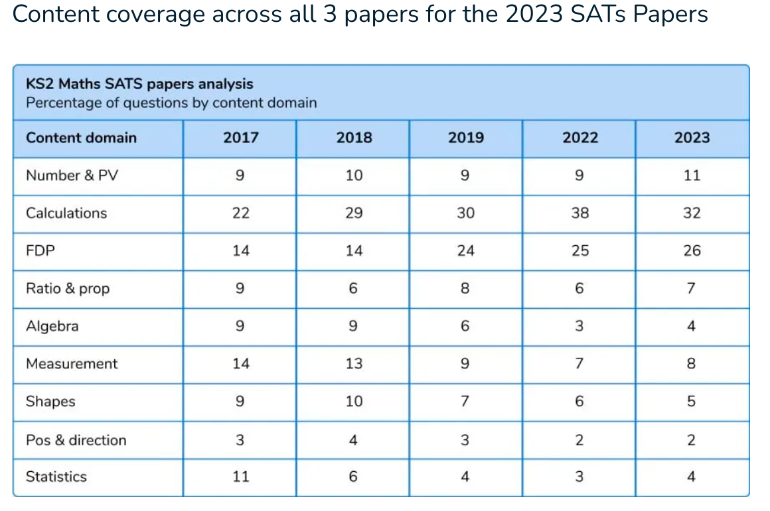

Slide 5
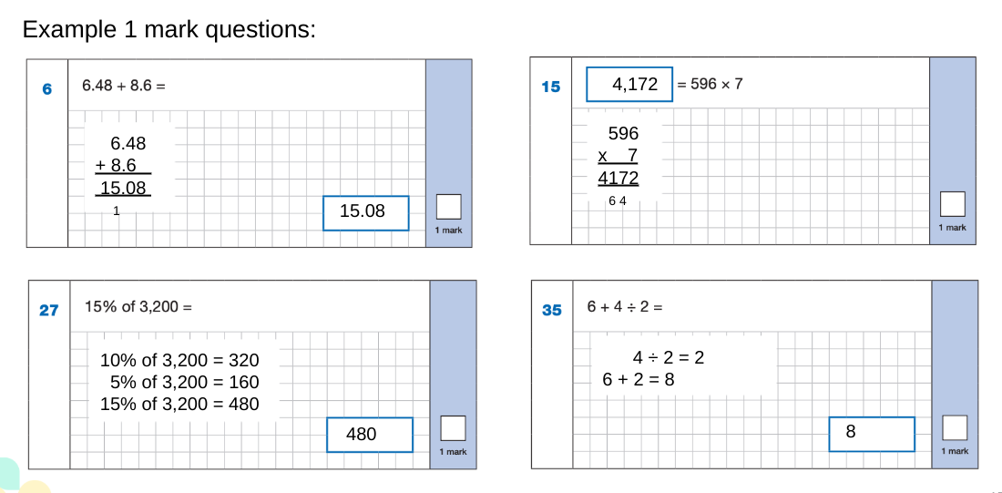
Sample Questions - Arithmetic
The maths arithmetic paper has a total of 40 marks and lasts for 30 minutes.
These are examples of how children could solve the calculations. There are some that could/ should be solved mentally as it is far quicker that way (40 marks in 30 minutes does not allow for 1 minute + per mark). Some questions are worth 2 marks.
Answers should always be given in their simplest form unless stated otherwise.

Slide 6
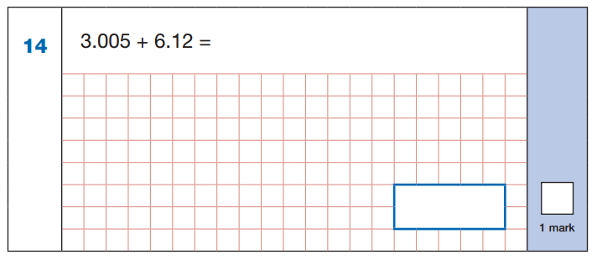
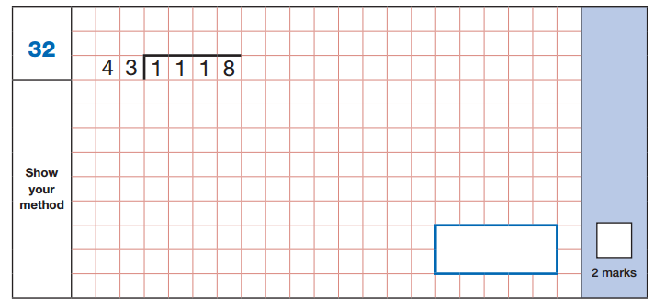
SAMPLE QUESTIONS
Maths Paper 1: Arithmetic

Slide 7
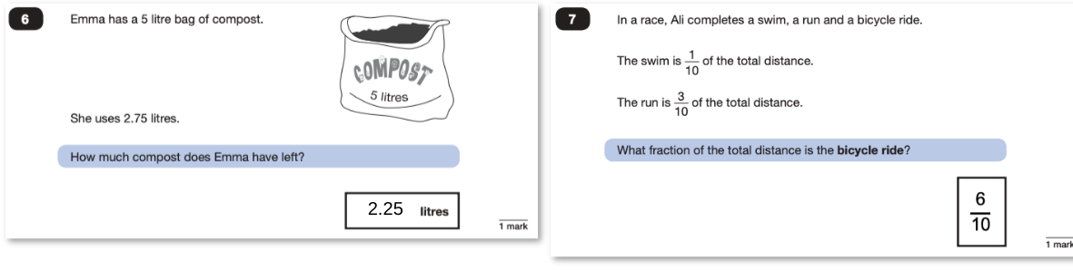
Sample Questions - Reasoning
Paper 2 will take place on Wednesday 15th May and paper 3 will take place on Thursday 16th May. These tests have a total of 35 marks each and lasts for 40 minutes each.
In general, the questions get progressively harder throughout the paper. As this is the case, it is not unusual for children to be unable to complete the entire paper in the given time.

Slide 8
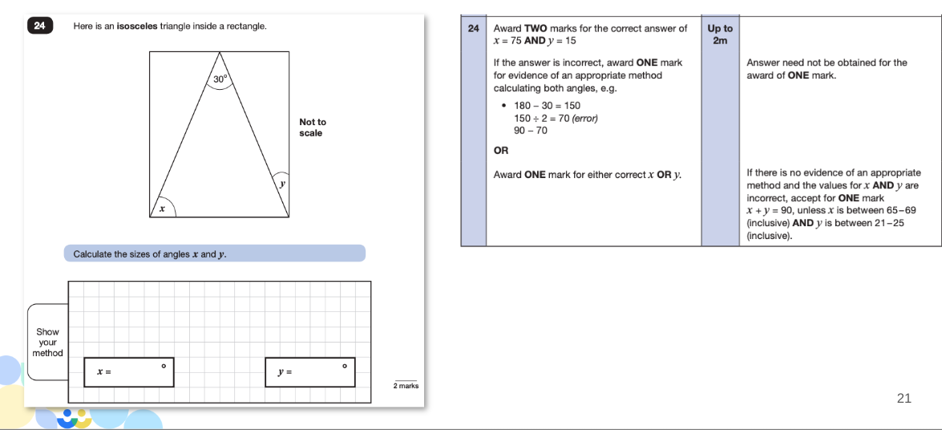

Slide 9
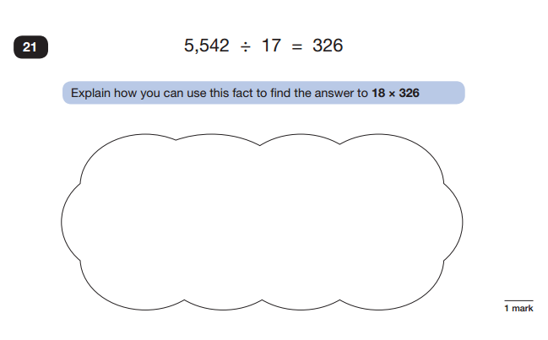
SAMPLE QUESTIONS
Maths Paper 2 / Paper 3 : Reasoning

Slide 10
Let’s give it a go together!
Mark Scheme
Arithmetic Paper
Reasoning Paper 2
Reasoning Paper 3

Slide 11
Maths Tips
Play times tables games/ times tables rockstars.
Play mental maths games including counting in different amounts, forwards and backwards.
Encourage opportunities for telling the time.
Encourage opportunities for counting coins and money; finding amounts or calculating change when shopping.
Look for numbers on street signs, car registrations and anywhere else!
Look for examples of 2D and 3D shapes around the home.
Identify, weigh or measure quantities and amounts in the kitchen or in recipes.
Play games involving numbers or logic, such as dominoes, card games, darts, draughts and chess.

Slide 12





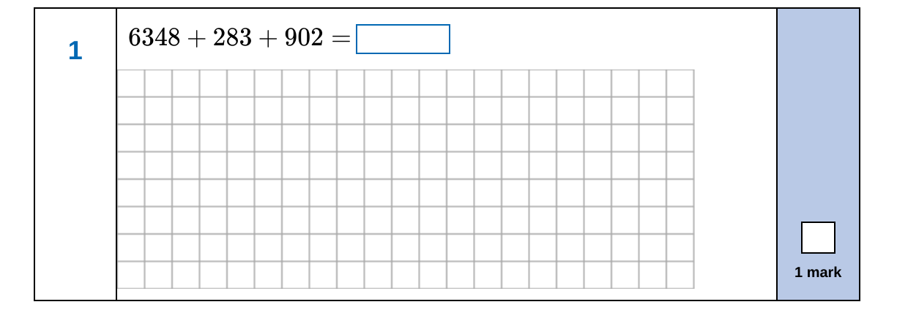
How do I know where to start?
https://mathsbot.com/primaryMenu

Slide 13
ANY QUESTIONS?

