Slide 1


Thursday 8th February, 2024
Year 6 SATs Workshop -
Reading

Slide 2
What are the SATS tests?
•The end of KS2 assessments are sometimes informally referred to as ‘SATS’.
•SATS week across the country begins on 13th May 2024
•Pupils will complete test papers in some of the areas that have to be assessed. Other areas, like writing, are assessed using evidence collected by the teacher over a longer period of time.
•Pupils will complete SATS test papers in:
- Reading
- Grammar, Punctuation & Vocabulary
- Spelling
- Arithmetic
- Mathematical Reasoning – 2 papers

Slide 3
READING
The reading test consists of a single test paper with three unrelated reading texts. Children are given 60 minutes in total, which includes reading the texts and answering the questions.
A total of 50 marks are available.
Questions are designed to assess the comprehension and understanding of a child’s reading.
During the reading paper, a child’s inference and deduction skills are thoroughly tested. They will also be expected to answer questions on authorial choices: explaining why an author has chosen to use particular vocabulary, grammar and text features.
Some questions are multiple choice or selected response; others require short answers and some require an extended response or explanation.
Notes:
LH

Slide 4

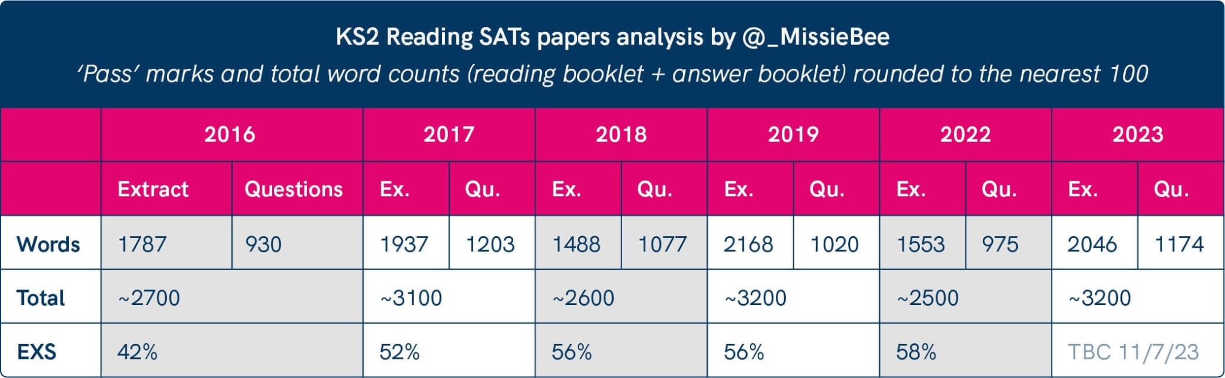
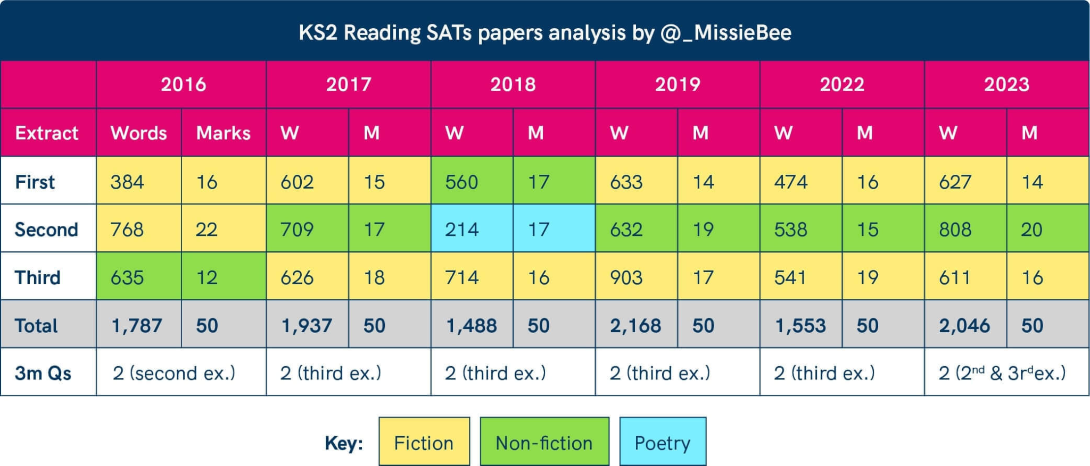
Equipping our children for end of KS2 expectations
In this year’s reading booklet, children were asked to read a total of 2,106 words split into three separate texts. This is one of the longest reading booklets ever used in the KS2 tests - and almost at the limit of the 2,300 words for the texts that is set as the maximum number.
DfE Guidelines say that a Sats pupil is expected to be able to read a minimum of 90 words per minute. This means reading the booklet alone would take 23 minutes and 30 seconds, leaving just 36 minutes and 30 seconds to answer the test questions. But this isn’t the only reading that pupils are expected to do. In the question booklet, there are many more words to be read - 1,337 in fact.
That will take our 90-words-a-minute reader another 14 minutes and 51 seconds to read - but we will round that up to 15 minutes to give them time to turn the pages. So there are now just 21 and a half minutes to answer 38 questions - meaning you have to give an answer every 34 seconds (this includes the time it will take to go back and re-read a passage to get their answer).
What’s more, with a maximum of 50 marks in total to be had in the paper from these questions, it means you are trying to “score” a mark every 25 seconds.
Notes:
HF
The importance of reading throughout the school. Focusing on the progression of reading, sets children up for a clear understanding of fluency. The more they are exposed to the key skills; Word reading -decoding, Prosody - tone, intonation and emphasis, and Comprehension - understanding the text, the more progress they will make.
The guidance above is taken from the last SATs analysis.
Readers who perform at or near target norms should be considered as progressing adequately in automaticity. Readers who are significantly and consistently below (or above) the norm span for their grade level and time of year may be at risk in their reading fluency development.

Slide 5
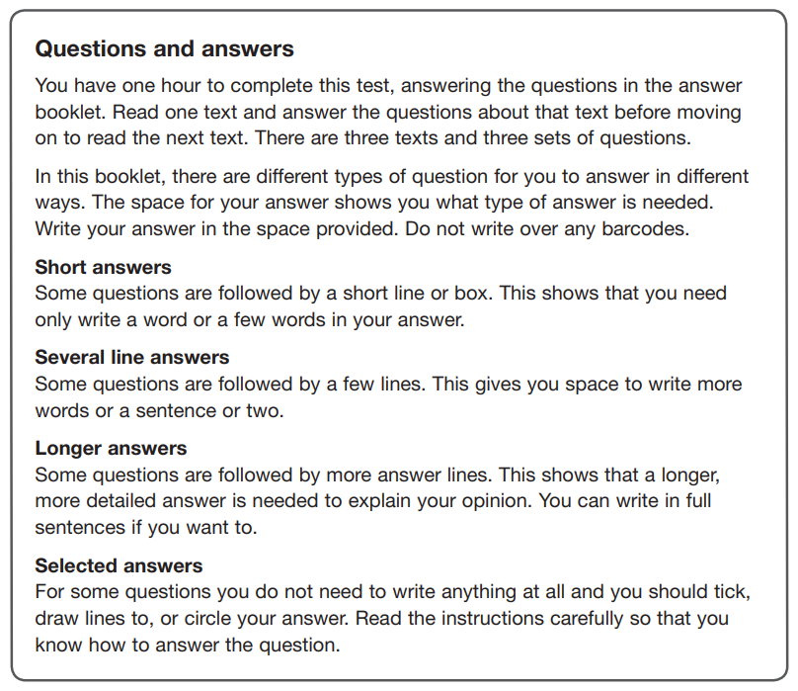
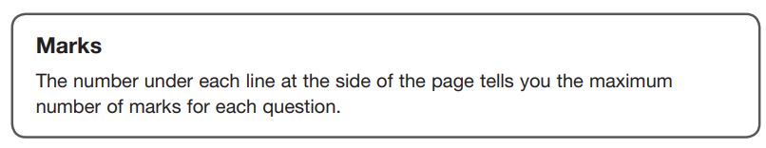
Question Types & Guidance

Slide 6
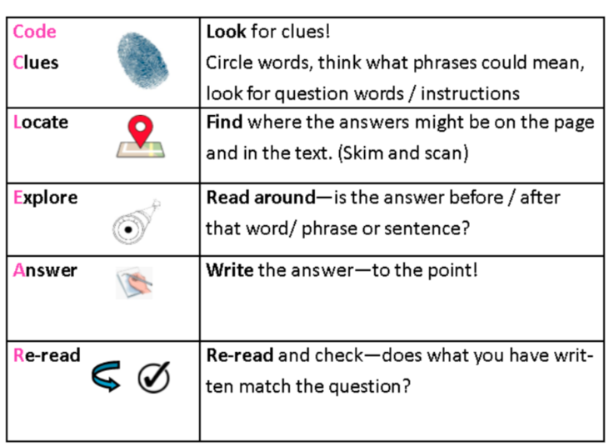

Slide 7
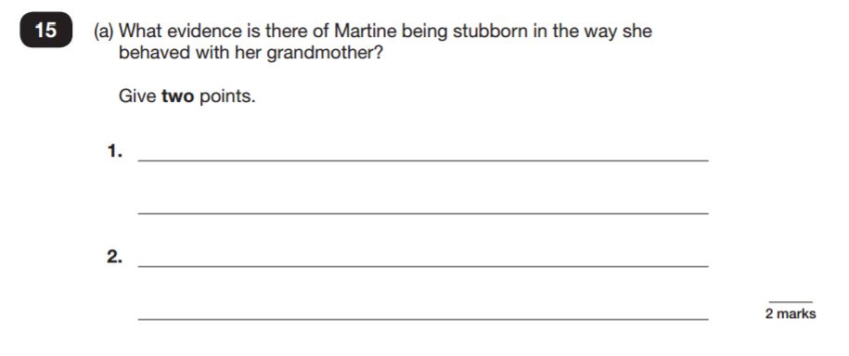
SAMPLE QUESTIONS
Reading Paper

Slide 8
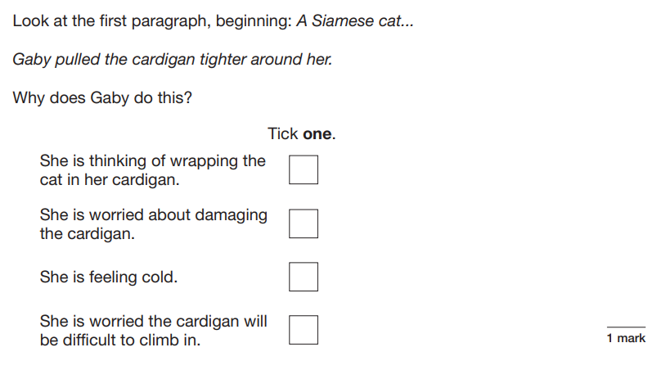
SAMPLE QUESTIONS
Reading Paper

Slide 9
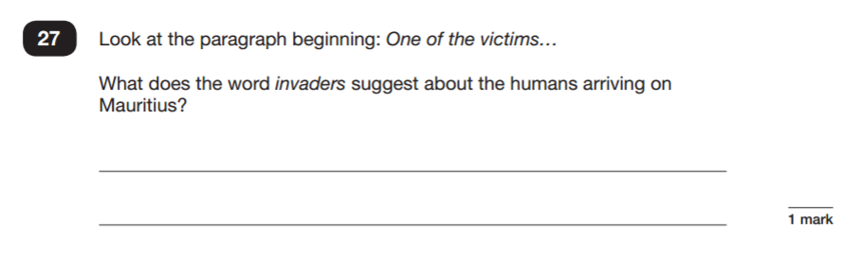
SAMPLE QUESTIONS
Reading Paper

Slide 10
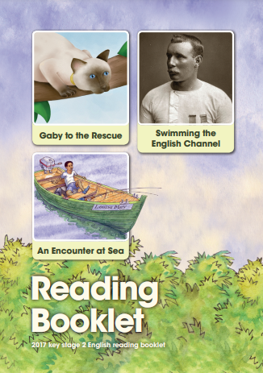
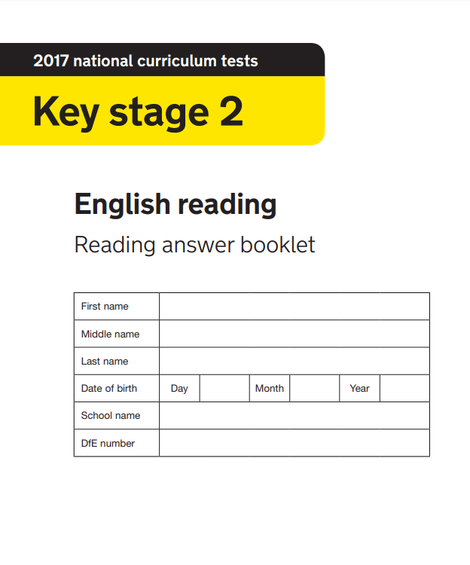
Let’s give it a go together!
Reading Booklet
Answer Booklet
Mark Scheme

Slide 11
HOW TO HELP YOUR CHILD WITH READING
Listening to your child read can take many forms.
First and foremost, focus developing an enjoyment and love of reading.
Enjoy stories together – reading stories to your child at KS1 and KS2 is equally as important as listening to your child read.
Read a little at a time but often, rather than rarely but for long periods of time!
Talk about the story before, during and afterwards – discuss the plot, the characters, their feelings and actions, how it makes you feel, predict what will happen and encourage your child to have their own opinions.
Look up definitions of words together – you could use a dictionary, the Internet or an app on a phone or tablet.
All reading is valuable – it doesn’t have to be just stories. Reading can involve anything: fiction, non-fiction, poetry, newspapers, magazines, football programmes and TV guides.
Visit the local library - it’s free!

Slide 12
ANY QUESTIONS?

